Slide 1
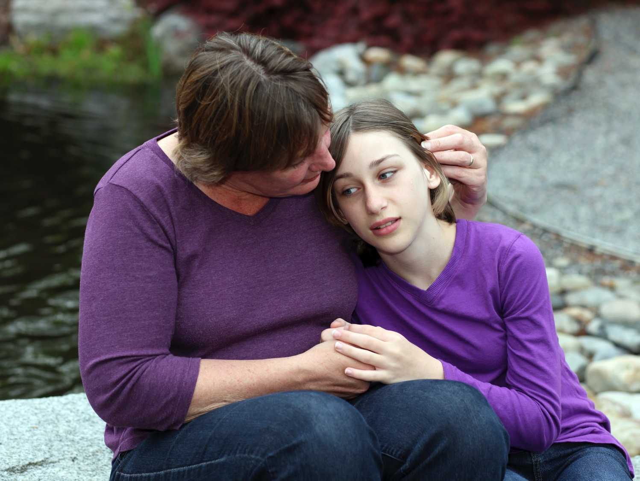
MODULE ONE
the impact of trauma
TST-FC

Slide 2
Welcome!

Slide 3
Goals for Today
Participants will be able to | Trainers will help you to
Describe trauma’s effects | Connect the idea of trauma response to behavior you see in the home
Share a definition of trauma | Shift thinking
Understand how a child’s trauma history affects his or her behavior in your home | Support your role
 | Define the role of a caregiving team

Slide 4

Getting to Know You
Group Activity

Slide 5
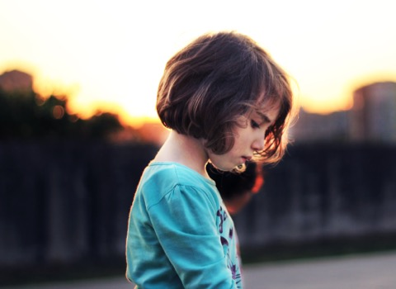
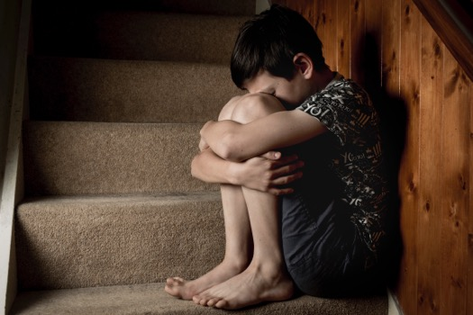
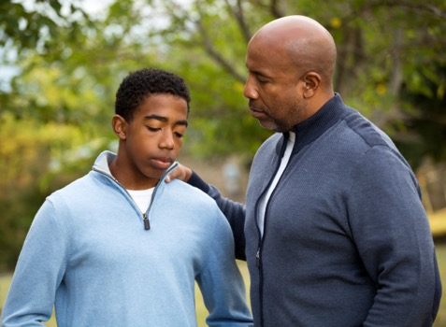
Many Children Have Experienced Trauma
  Among children 0-17, nearly half have experienced
  at least one or more types of childhood trauma
With each trauma exposure, caregiving can be
more challenging

Slide 6

For Children of Color, or Who Identify as LGBTQ,
Trauma Can Be Even More Complex
How might a child’s race, ethnicity, gender or sexual identity affect how he or she experiences the world?
Consider that for some children, current events and the things they see or hear in the news may be trauma triggers

Slide 7
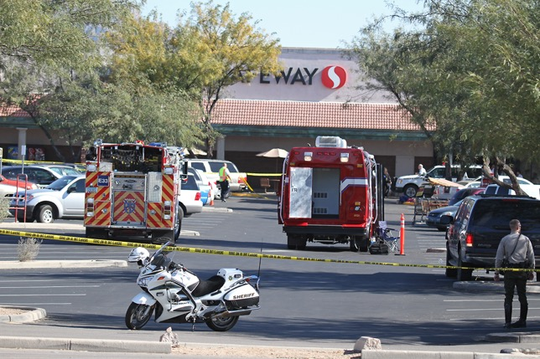
A Definition of Trauma
Trauma is a life-threatening or extremely frightening
experience — for the child or someone they care about —
that overwhelms the child’s capacity to cope.

Slide 8
Three Types of Trauma
  Acute
  Chronic
  Complex

Slide 9

Let’s Talk
What do we do to try to cope?
  Internally or within ourselves?
  Externally or through activities
  outside of ourselves?

Slide 10

Survival-in-the-Moment States
Survival-in-the-moment states affect a child’s mental, emotional and physical well-being, including the following:
      Awareness of self and the environment
      Experience of intense feelings
      Physical responses
      Ability to cope

Slide 11


Slide 12
Survival Responses That Become Patterns
            Fight
            Flight
            Freeze

Slide 13
Let’s Talk
Think about kids you have worked with or know.
What behaviors do you observe in children who
engage in the following survival responses of:
  Fight?
  Flight?
  Freeze?
Break into groups:
  Have three Post-it® notes on hand
  (one for fight, one for flight, one for freeze)
  Discuss what you see in children when they use these strategies
  Write your group’s answers on Post-it® notes

Slide 14
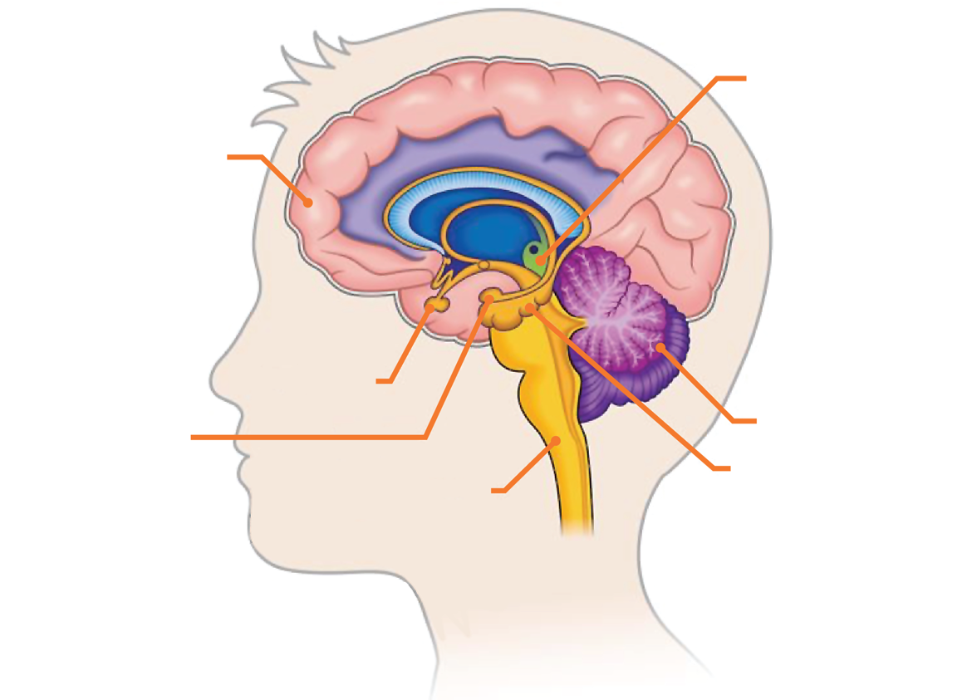
The Brain
HYPOTHALAMUS
Regulates hormones that control sleep, mood, hunger
PREFRONTAL CORTEX
Manages planning, assessing, moral reasoning, complex decision making
CEREBELLUM
Receives sensory information, coordinates movement, posture, balance
PITUITARY GLAND
AMYGDALA
Detects fear, memory, fight, flight, freeze
BRAIN STEM
Controls heart rate, respiration, muscle movement, swallowing
HIPPOCAMPUS
Regulates long-term memory

Slide 15
When a Trigger Causes an Emotional and
Behavioral Response
HIGH ROAD: 30-40 milliseconds
CORTEX
Sensory cortex: Perception
Medial temporal: Context
Pre-frontal: Awareness
STIMULUS
RESPONSE
HIPPOCAMPUS
Memory
THALAMUS
Sensory
AMYGDALA
LOW ROAD: 8-10 milliseconds

Slide 16
If Thinking Shuts Down, What Takes Over?
Reacting — survival response only!
Understanding the problem, gathering information, developing a plan, taking action
Eventually, the system will return to baseline

Slide 17
The High Road and the Low Road
LOW ROAD
HIGH ROAD
Handles immediate threat
Is lightning fast
Acts reflexively
Focuses on information from senses
Loses details
Plans, problem solves
Takes longer
Allows child to be “mindful”
Uses information from words, concepts, thoughts
Analyzes details

Slide 18
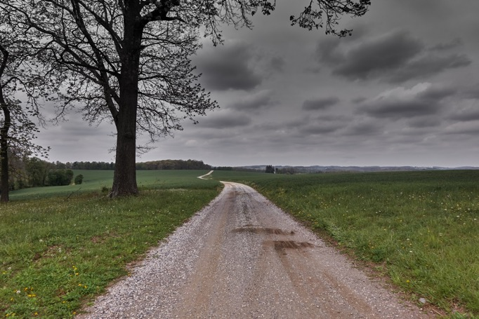
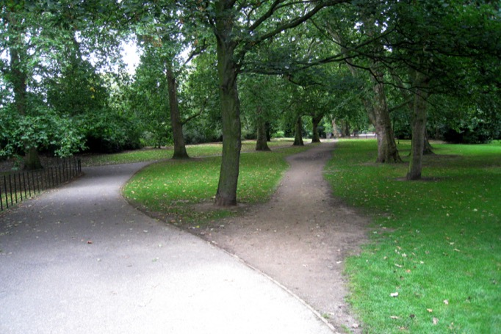
Am I Safe?
Faced with trauma reminders, children respond as if they are in danger, even when they are not, using the same, worn pathways

Slide 19
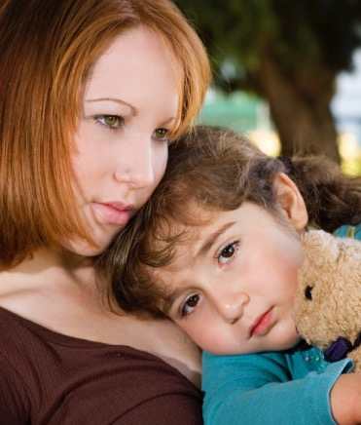
The Child I Care About Worksheet
Questions 1, 2, 3a and 3b

Slide 20
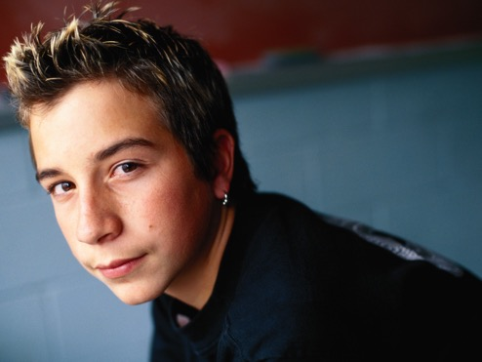

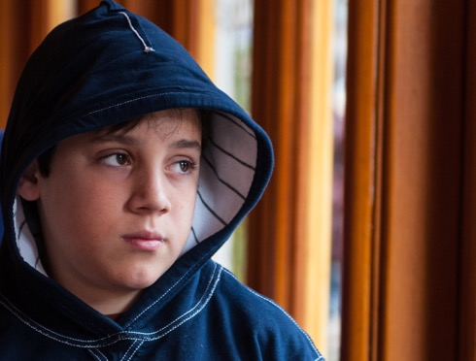
Meet john, Sophia and Hector

Slide 21
Let’s Talk
Work together as a group to answer the four questions at the bottom of your worksheet

Slide 22

JOHN
Is always looking for trouble
Has problems with rules and limits
Has had four foster placements in two years
Is often the subject of calls from school
His current foster parents are supportive but are losing patience and hope
DIAGNOSIS:
Oppositional Defiant Disorder

Slide 23

SOPHIA
  Fears women, including teachers
  Won’t go to school near home
  Hides
  Leaves without permission
DIAGNOSIS:
Anxiety disorder
and school refusal

Slide 24

HECTOR
  Is the quiet kid in class
  Has no behavioral problems but is often spacey and silent
  Gets bullied in school
  Is failing his classes
DIAGNOSIS:
Adjustment anxiety
disorder and depression

Slide 25
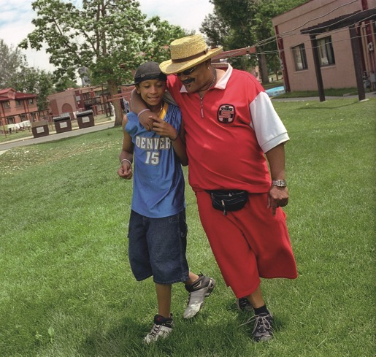
The Child I Care About Worksheet
Question 4

Slide 26
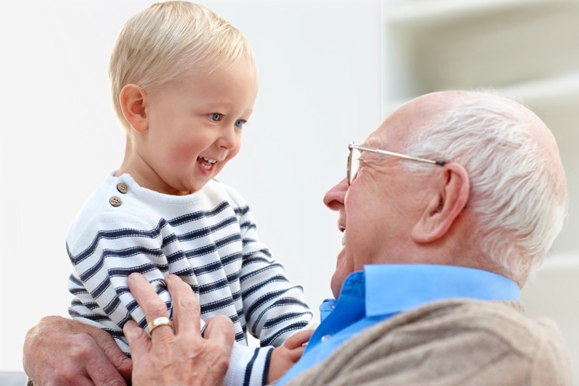
Experiences, Both Positive and Negative,
Affect Brain Functioning

Slide 27

Because of Trauma, Children May
Have a Broken OFF Switch
The brain does not realize
the danger is over

Slide 28

Living on the Balls of Your Feet

Slide 29
How Fight, Flight or Freeze Become a Behavior Pattern
Trauma starts the child’s emergency response system of fight, flight, freeze
When exposed to ongoing or intense levels of threat, a child’s response of fight, flight, freeze can become a patterned response
With overuse, survival responses can be triggered by just being reminded of a child’s past trauma
These patterns can have lifelong effects

Slide 30
Children Do Not Live in Isolation
Just asking what has happened is not enough. Learn what is going on in a child’s environment:
In your home
At school
During time with family
In his or her neighborhoods
In his or her faith and cultural communities
SOCIETAL
COMMUNITY
RELATIONSHIP
INDIVIDUAL

Slide 31

Small Changes Can Have a Big Impact

Slide 32
The Trauma System
A traumatized child
A social environment
who experiences survival-in-the-moment states in specific, definable moments
or system of care that is unable to help the child regulate these survival-in-the-moment states

Slide 33
An interesting experiment
with playful rats

Slide 34
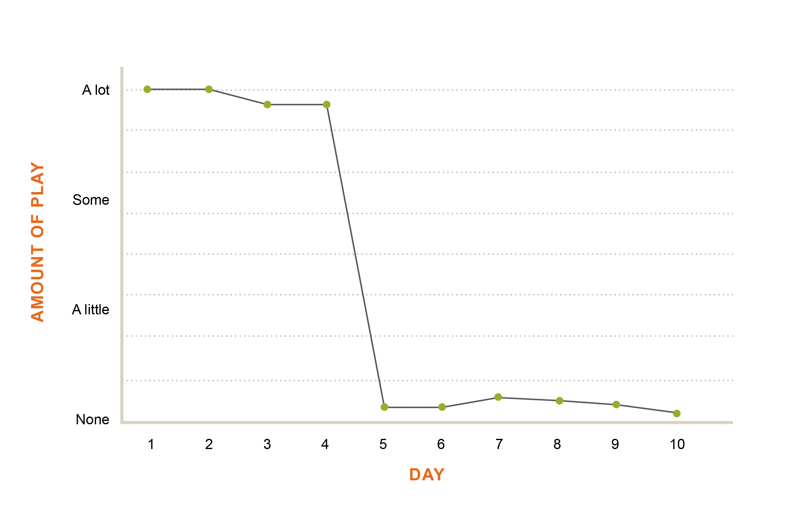
Amount of Play Over 10 Days
Cat hair introduced
Cat hair removed
In Panksepp, J. P. (1998). Affective neuroscience: The foundation of human and animal emotions. New York: Oxford University Press.

Slide 35
Reminders of Past Dangers
Survival-in-the-moment responses can occur
when a child is in actual danger or is merely
reminded of danger
Even when dangerous events have passed,
the child’s memories and survival
behaviors often remain

Slide 36
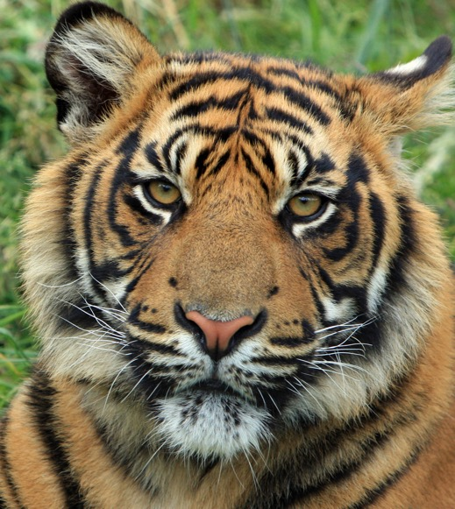

Where Is the Cat and Where Is the Cat Hair?

Slide 37
Possible Cat Hair or Trauma Reminders
Sensory | Time Driven | Conditions
Smells Sights Sounds Physical contact Tastes | Anniversary dates Holidays Seasons Times of the day | Loss of control Such as things being taken away, being told “no” or re-directed Transitions Changing from one activity to another Going from the familiar to the unknown

Slide 38
Stages of Behavior (the 4 R’s)
 | Regulating | Revving | Re-experiencing | Reconstituting
CHILD BEHAVIOR | Restful. Child is calm and engaged in his or her environment | Vigilant. Child has been triggered and is trying to manage emotions | Fight, flight or freeze. Child’s coping skills are overwhelmed; s/he is struggling | Calming down. Child is beginning to manage emotions and re-engage
YOUR PRIORITY | Minimize triggers to prevent escalation | Help your child regulate emotion | Make sure your efforts to contain the child do not re-traumatize him or her, keep the child and others safe | Help your child continue to manage emotions and re-engage

Slide 39
Shifts in the 4 R’s Affect the 3 A’s
    The 3 A’s include:
    Affect: How people display their feelings, especially on their faces or in their body language
    Awareness: A child’s sense of him- or herself, what is going on in the environment and what he or she seems focused on
    Action: How a child behaves

Slide 40
Let’s Talk
How have you seen these shifts
in the children you care for?

Slide 41
Trauma May Spark Challenges
    Children experiencing trauma reminders may struggle with the following:
    Verbal or physical aggression
    Strong feelings (rage, terror, anxiety)
    Concentration and learning
    Relationship challenges (trusting and respecting)
    Shutting down emotionally (avoiding or isolating)
    Making inappropriate choices and self-harming
Think fight, flight or freeze —
Not willful, defiant troublemaker

Slide 42
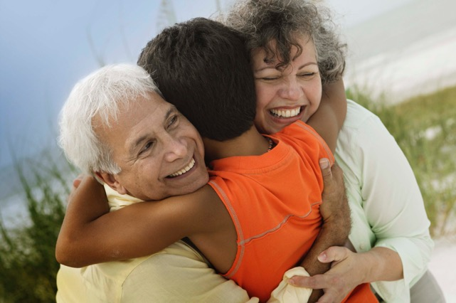
Worksheet: The Child I Care About
Questions 5 and 6

Slide 43

You Are a Key Member of the Child-Serving Team
You can help the team understand the connection between the child’s past trauma — their cat hair — and the survival-in-the-moment responses you see
Also on the team: social workers, day care providers, foster parents, therapists, teachers, coaches, other caregivers

Slide 44


Homework and Questions
Homework
Complete “The Child I Care About” worksheet
Questions
    Put questions in the question box, or
    Email one of us:

Slide 45

Next Session
Date and time
Place

