Slide 1
Child Protection and Crime Victims
Protecting children while honoring Crime Victims’ Rights

Slide 2
History of Crime Victims’ Rights in Connecticut
1996
CT residents overwhelmingly voted to amend the State Constitution to provide crime victims with Constitutional rights
1998
Creation of the Office of the Victim Advocate – the enforcement agency for crime victims’ rights
2015
Creation of the Victims’ Rights Enforcement Advisory Commission - recommendations submitted to the Governor

Slide 3
Mission Statement
The Office of the Victim Advocate (OVA), seeks to ensure that the victims of crime become an integral part of the criminal justice system. Through public education of the rights and services available to crime victims, collaboration with law enforcement and service providers, as well as court and legislative advocacy, the OVA believes that the voices of crime victims will become a necessary component of our state.

Slide 4
Office of the Victim Advocate (OVA)
State Victim Advocate
Natasha M. Pierre, JD, MSW
Appointed by the Governor
Staff Attorney
Hakima Bey-Coon
Complaint Officer
Merit Lajoie
Administrative Assistant
Vanessa Torres

Slide 5
OVA Statutory Mandates
Evaluate the delivery of services to victims by state agencies and those entities that provide services to victims
Coordinate and cooperate with public and private entities
Review the procedures established by any state agency or other entity providing services to victims
Receive and review complaints of persons concerning the actions of any state agency or other entity
Conduct investigation when necessary
File limited special appearance in any court to advocate for any State Constitutional or Statutory rights
Ensure a centralized location for victim services information
Recommend changes in state policy or legislation concerning victims
Conduct programs of public education and outreach
Monitor the services provided by the Witness Protection Program

Slide 6
Evaluate the delivery of services
Receive complaints from crime victims
Resolve initial complaint
Evaluation of policies/procedures
Services of the Medical Examiner and Witness Protection Program
Is the complaint systemic
Coordinate and cooperate with public and private entities
Identify gaps in services
Availability of services
Information to crime victims

Slide 7
Advocacy and Enforcement
Court advocacy
File limited special appearance
Conduct investigations
Highlight gaps
Legislative advocacy
Recommend legislation
Written notification to court
Opportunity for change
Advance crime victims’ rights

Slide 8
Public Education & Outreach
Public awareness
Crime Victims’ rights and services
Central location for crime victim information
Trainings
Public or private entities
Cross training for criminal justice community
Information
Social Media/Website
Printed materials/brochures
OVA versus OVS
Crime Victim Guide

Slide 9
Crime Victims’ Constitutional Rights

Slide 10
CONSTITUTION of the STATE of CONNECTICUT
Article XXIX - Rights of Victims of Crime
In all criminal prosecutions, a victim, as the General Assembly may define by law, shall have the following rights:
To be treated with fairness and respect throughout the criminal justice process;
To timely disposition of the case following arrest of the accused, provided no right of the accused is abridged;
To be reasonably protected from the accused throughout the criminal justice process;
To notification of court proceedings;
To attend the trial and all other court proceedings the accused has the right to attend, unless such person is to testify and the court determines that such person’s testimony would be materially affected if such person hears other testimony;
To communicate with the prosecution;
To object to or support any plea agreement entered into by the accused and the prosecution and to make a statement to the court prior to the acceptance by the court of the plea of guilty or nolo contendere by the accused;
To make a statement to the court at sentencing;
To restitution which shall be enforceable in the same manner as any other cause of action or as otherwise provided by law;
To information about the arrest, conviction, sentence, imprisonment and release of the accused.

Slide 11
Crime Victims’ Constitutional Rights
Treatment
The right to be treated with fairness and respect
The right to timely disposition of the case
Information
The right to notification of court proceedings
The right to information about the arrest, conviction, sentence, imprisonment and release of the accused
Participation
The right to attend all court proceedings
The right to communicate with the prosecution
The right to be reasonably protected from the accused
The right to be heard at plea and at sentencing
The right to restitution

Slide 12
What the Constitutional rights DON’T mean
Treatment
Crime Victims do not dictate the progress of the criminal justice process
Crime Victim rights do not “trump” defendant rights
Participation
Crime Victims do not possess VETO power over plea agreements or dispositions
Crime Victims are not a “party” in the criminal matter (State v. defendant)
Enforcement
Violation of a Crime victim’s right is not a basis for vacating a conviction
Crime Victims cannot appeal a conviction or sentence

Slide 13
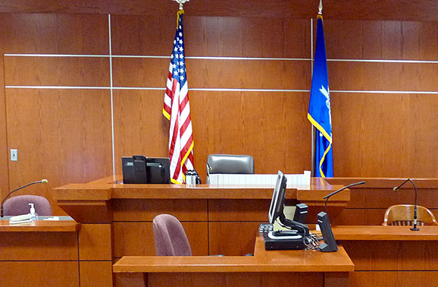
Criminal Justice Process

Slide 14
Understanding the criminal justice process

Slide 15
Criminal Justice Process
Police Investigation
Can take months
Arrest of the Offender
Release on Bond
Conditions of Release (issued by police-temporary)
Arraignment (first court appearance)
Consideration of bond
Review and set conditions
Orders of Protection
Referral to Family Relations

Slide 16
Criminal Justice Process
Pre-trial Stage
Diversion Programs
Family violence education program: Crime Victim has the right to be heard
Alcohol/drug education program
Explore/Evolve programs (26 session or 52 session): Requires a conviction
Negotiated plea agreement or Trial
Pre-sentence Investigation Report (PSI): Crime Victim Impact Statement
Sentencing
Crime Victim has the right to be heard
Post-conviction
Release from custody
Probation/Parole/Special Parole

Slide 17
The Criminal Justice System: How does the OVA fit in?
Crime
Victim
Police
Advocate
Services
Prosecutor
Court
Post-conviction

Slide 18
Victim of Domestic Violence
Contacts the OVA
Complaint about DCF
Crime Victim contacted by criminal court
Family relations officer
Domestic Violence Victim Advocate
Non-offending parent
Weight of cooperation
Unintended consequence
Ombudsman Office
Referred for complaints not involving Crime Victims’ rights
Office of the Child Advocate
Oversee child protection
Ancillary needs of victim
Child care
Support
Transportation

Slide 19
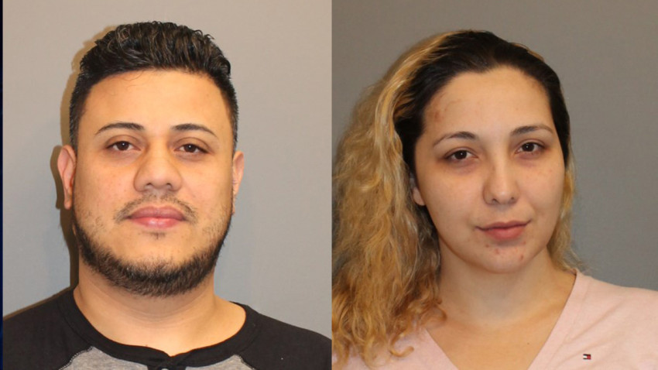
A woman and her boyfriend are suspected of abusing her child and Norwalk police have arrested them. 31-year-old Lisbeth Castillo-Cruz and 35-year-old Jose Valenzuela, both of Danbury, are accused of hitting the child with a belt several times.
Police said the child was also struck with a phone cord and punished by being forced to hold books over his or her head until it hurt.
Police received the complaint from the State Department of Children and Families on January 16th and arrest warrants were issued on February 24th.
Detectives from the special victims unit found the two suspects at separate locations in Danbury and they were transported to the Norwalk Police Department.
Valenzuela was charged with cruelty to persons, third-degree assault and risk of injury to a minor. Bond was set at $100,000 and he posted bond.
Castillo-Cruz was charged with cruelty to persons and risk of injury to a minor. Her bond was set at $75,000 and she posted it. The cases are still pending.
Who will represent the crime victim in criminal court?
Non-offending parent;
Guardian ad litem; or
DCF?

Slide 20
Notification of court case/offender status
SAVIN
(Statewide Automated Victim Information and Notification System)
Register to receive notification of a pending court case or the status of an incarcerated offender
Information is limited (often requires follow-up communication)

Slide 23
Juvenile Justice System
Juvenile Victim
Juvenile Offender
Maintain limited rights in juvenile court
Offender often known
May be DCF involved
Balance of privacy rights
Access to information
Representation
Parent/Caregiver/Guardian/GAL
Rehabilitation focus
Treatment programs
Limits of juvenile court
May be DCF involved
Prior victimization
Environmental factors
Family unit
Economic status
Supervision

Slide 24
Minor victims and Identity theft
Protect personal information
FERPA (protects student records)
Request credit history/freeze
On-line safety
Warning signs
Credit card application
Jury notice
Thief often known (parent; relative; friend)
Report any activity to Federal Trade Commission
Federal Trade Commission Identity Theft Recovery Plan
(https://www.consumer.ftc.gov/articles/0040-child-identity-theft/#Repair)

Slide 25
Office of the Victim Advocate
505 Hudson Street, 5th Floor
Hartford, CT 06106
(860) 550-6632
Toll free (CT) (888) 771-3126
www.ct.gov/ova
Email: OVA.Info@ct.gov
Protection, Promotion and Enforcement of Crime Victims’ Constitutional and Statutory Rights

Slide 26
Questions?
Thank you for attending.

