Slide 1
The Time to Grow
Meeting the Needs of all Connecticut youth aging out of state care

Slide 2
Aging Out
What is ‘aging out’?
When DCF is unable to achieve reunification, adoption, or transfer of guardianship

Slide 3
Extended Foster Care
Fostering Connections to Success and Increasing Adoptions Act (2008)
Amended in 2010 to give states the option to expand foster care to 21
Extended foster care is voluntary

Slide 4
Pathways to exiting care in CT
Voluntarily, at or after age 18;
After fulfilling their educational goals; or
Involuntary, due to noncompliance with DCF expectations

Slide 5
What are the requirements for extended foster care in CT?
Completing high school or equivalent degree
Enrolled in post-secondary or vocational education
Participating in a program or activity designed to promote, or remove barriers to, employment

Slide 6
What are the requirements for extended foster care in CT?
Does not include:
Working 80 hours per month
Physical or mental impairment prohibits them from accomplishing any of the above

Slide 7
Additional Facts
Deferment
Part-time attendance
Minimum requirements
Funding
Second PSE opportunities

Slide 8
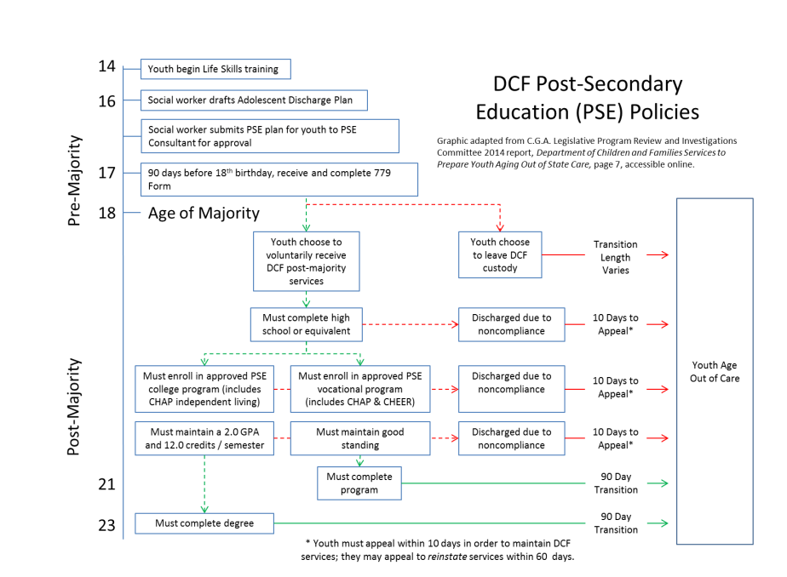

Slide 9
Research & Data
Youth in Foster Care
Youth Exiting Foster Care
Youth Outcomes

Slide 10
What does research tell us?
Extended foster care alone may not cause an increase in positive outcomes but may increase
Likeliness of college attendance
Increased earnings
Does not prevent homelessness, & points to the need of increased supports

Slide 11
CT Youth in Foster Care*
26 percent of youth in foster care were between the ages of 16 – 20
7 percent of youth exited foster care through emancipation
276 youth aging out of care
13.8 percent of children in placement have an OPPLA goal as of 09/2018
* Data is from 2016 unless otherwise noted

Slide 12
Youth Outcomes*
*data provided by the Department of Children and Families

Slide 13
Youth Outcomes*
*data provided by the Department of Children and Families

Slide 14
Youth Outcomes*
*data provided by the Department of Children and Families

Slide 15
Questions?
For more information, please see the full research report on our website:
“The Time to Grow: Meeting the Needs of Connecticut Youth Aging out of Foster Care” (2016). By Nicole Updegrove and Lauren Ruth, Ph.D.

Slide 16
Contact Us
Website: http://www.ctvoices.org/
Twitter (@CTVoices): twitter.com/CTVoices
Facebook: www.facebook.com/CTVoicesforChildren/
Tableau: public.tableau.com/profile/connecticut.voices.for.children
Sign up for email alerts!
Stephanie Luczak
sluczak@ctvoices.org
203-498-4240 x 116
Jessica Nelson
jnelson@ctvoices.org
203-498-4240 x 199

