Slide 1


CT Birth to Three System
A division of the Office of Early Childhood (OEC)
November 16, 2020

Slide 2









OUR WORK
OEC is a state agency that oversees a network of programs and services that help young children and families thrive. OEC is made up of various divisions and programs which include:
Early Care and Education (ECE)
Support more than 400 ECE programs serving over 40,000 children
Care 4 Kids
Provide child care funding for low - and -moderate income families who are working or participating in education
Home Visiting
Provide parenting and child development support to families of young children and pregnant women
Birth to Three
Provide supports for families whose children have developmental delays
Parent Cabinet
Coming soon!
Licensing
License and inspect more than 4,000 child care and youth camp programs to ensure health and safety
Background Checks
Oversee comprehensive background checks for child care providers
Quality Improvement
Provide early childhood professionals with supports to improve child care practices
Agency Administrative Functions
Fiscal, Legal, Communications, Information Technology, Data & Research
Government & Community Relations
Outreach and engagement with key stakeholders and partners
Notes:
Find more icons at flaticon.com. Download as SVG and place into presentation. You can then change the Fill color.

Slide 3
WHAT WE
WILL DISCUSS TODAY:
Part C Services-general overview
Funding and fees
Referral process
Evaluation and assessment
IFSP (individual family support plan)
Supports (standard and remote)
Evidence-based practices
Transition (part B/SDE, reunification, community supports)

Slide 4

Part C Birth to Three in Connecticut

Slide 5
Part C
Part C of a federal law called the Individuals with Disabilities Education Act (IDEA), and state law §17a-248
Supporting families to enhance their child’s development and connect to their communities.
Birth to Three is a voluntary program

Slide 6
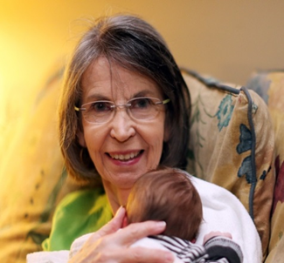
Birth to Three System Overview
Federal Dept. of Education, Office of Special Education Programs (OSEP)
Connecticut Lead Agency: Office of Early Childhood (OEC)
Annual Budget: ~$63 million (FY20)
Personnel: 6 staff (additional shared fiscal and IT support)
Statewide: 19 Comprehensive Early Intervention Programs
11 Autism Specialty Programs
3 Deaf/Hard of Hearing Programs
approx. 600 practitioners in total
FY20 Children/Families Referred: 9232 (down from 10287 in FY19)
Served in FY20 : 11885 (FY19 11996)
Visit Locations: 99% of visits are in the family’s home or community

Slide 7
Birth to Three Systems Funding
Parent fees are determined on a sliding fee scale.
All Parent fees are currently waived during the current PHE

Slide 8
SiMR and Parental Surveys
Parents of children who have a diagnosed condition will be able to describe their child’s abilities and challenges more effectively as a result of their participation in Early Intervention
“
I always feel respected by my team! – Maria, B23 parent
“
Parents are surveyed annually
Parents participate on the Inter-coordinating Counsel (ICC)

Slide 9
Who is on the team?
Every family is receives Service Coordination, usually by their primary interventionist.
EI Supports are provided by a team of practitioners from the following disciplines:
  Speech and Language Pathology (SLP)
  Developmental Therapists, Special Education Teachers
  Occupational Therapy (OT)
  Physical Therapy (PT)
  Social Work (LCSW) / Professional Counseling (LPC) / Marriage & Family Therapy (MFT)
  Clinical Psychology (PsyD)
  Licensed Behavioral Analysts (LBA)
  Nurses (RN, APRN)
  Audiology (AuD)
  Teachers of the Deaf (TOD)
  Vision and Mobility Specialists
As well as other supports including:
  Transportation or mileage reimbursement when necessary to receive other IFSP services
  Assistive technology devices and services
  Sign language instruction

Slide 10
Birth to Three Systems Referral
Single point of entry
211
Child Development Infoline (CDI) is the single point of entry for
Birth to Three, Help Me Grow, and other important childhood resources
Three ways to make a Birth to Three referral:
1-800-505-7000
    www.birth23.org/referrals
    fax referral form to CDI
  Anyone can contact CDI but only a “Parent” can give consent to proceed with the referral.
  What is a “parent” in Birth to Three?

Slide 11
Who is a “parent” under sec. 602.23 of IDEA
  a natural, adoptive, or foster parent of a child (unless a foster parent is prohibited by State law from serving as a parent);
  a guardian (but not the State if the child is a ward of the state);
  an individual acting in the place of a natural or adoptive parent (including a grandparent, stepparent, or other relative) with whom the child lives; or an individual who is legally responsible for the child’s welfare; or
  an individual assigned to be a surrogate parent.
  Uninterrupted Scholar’s Act gives DCF access to all B23 records of children in foster care

Slide 12

Rights of the parent/person acting as the parent
give consent for evaluation and services
authorize release of information from the child’s B23 record
refer a child to the nexus school district
have IDEA due process rights
If a child is under DCF oversight, DCF must sign consent for non-educational issues such as release of medical records or permission to bill Medicaid

Slide 13
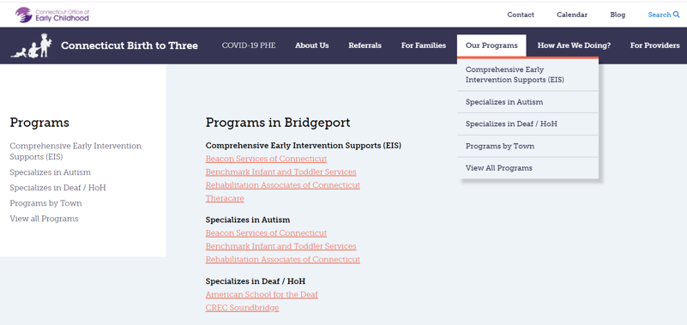
After CDI obtains Parental consent
Random rotation of programs servicing the town and open to receive new referrals
or
Specific program based on parent request

Slide 14
Evaluation: Standardized, norm-referenced evaluation tool
Two multidisciplinary professionals (one of which is a match for the domain of identified concern)
5 Domains
Cognitive
Communication
Motor
Adaptive
Social/emotional
In rare instances: informed clinical opinion supported by portions of appropriate tools
Must be supported by a standardized norm-referenced tool within 6 months
Diagnosed clinical medical
Diagnosed medical condition with high probability of developmental delay or
-2.0 SD in one domain or
-1.5 SD in two domains

Slide 15

“Not Eligible” based on multi-domain tool
Domain specific tool in area of concern
Still not eligible:
Re-refer after 1-3 months
Enroll in ASQ to track development
Access other resources
  Developmental information
  Community activities and agencies
Refer to School District when close to age three
CPAC (Child Parent Advocacy Center)
Mental health concerns: referred to a licensed professional

Slide 16
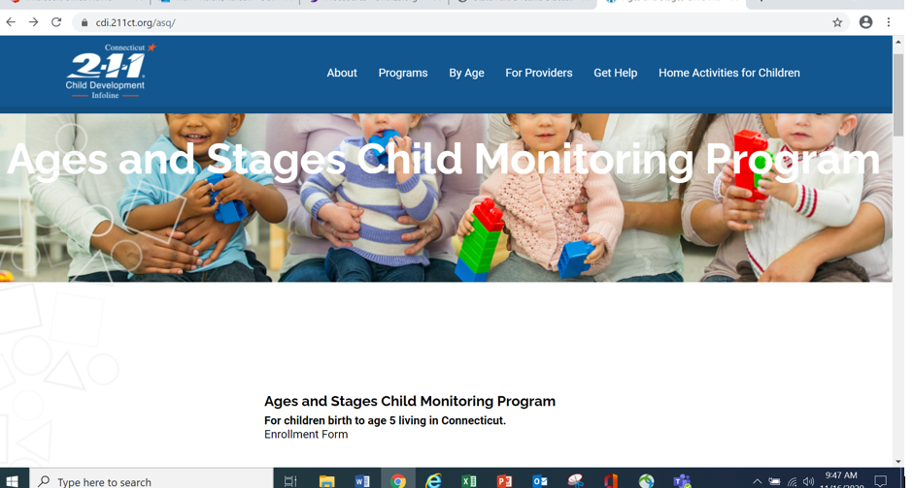
Ages and Stages Questionnaire (ASQ)

Slide 17
After Eligibility is determined and report is shared:
IFSP Meeting is held in a location and at a time convenient to the family.
Parents advised of their due process rights
Family routines are discussed
Strengths and challenges as they relate to individual family’s routines
Birth to Three supports are determined based on need
(who, when, how frequent, location)
Outside resources are considered with regard to areas of concern and family objective
Diagnosed clinical medical
The IFSP document:
Developed with family
Individualized
Family outcome in addition to child outcomes
Transition planning is started

Slide 18

Evidence-based practices (EBP)

Slide 19
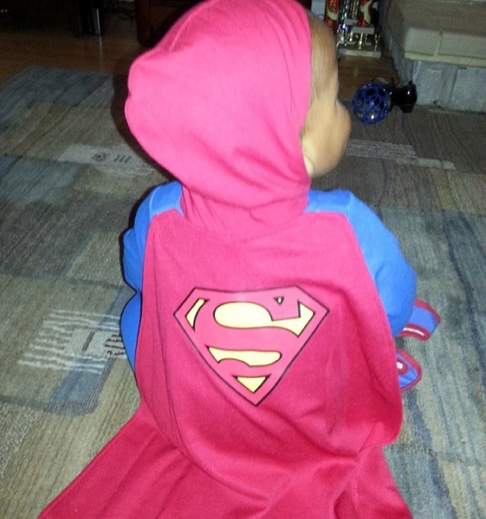
7 Key Principles
1. Infants and toddlers learn best through everyday experiences and interactions
with familiar people in familiar contexts.
2. All families, with the necessary supports and resources, can enhance their children’s learning and development.
3. The primary role of a service provider in early intervention is to work with and support family members and caregivers in children’s lives.
Notes:
There are 7 Key Principles and Practices for working in natural environments – Part C. GIVE HANDOUT – 7 Key Principles. Discuss.
We will discuss more on the research supporting this principle
Focus is on supporting family to meet their child’s needs. All families are competent in meeting their child needs – given proper supports.
We work with the adult, NOT the child. Very different than “medical model”

Slide 20

4.The early intervention process, from initial contacts through transition, must be dynamic and individualized to reflect the child’s and family members’ preferences, learning styles, and cultural beliefs.
5. IFSP outcomes must be functional and based on children’s and families’ needs and family-identified priorities.
Notes:
4. Entire process – Dynamic & Individualized. There is not a specific or “normal” type of supports for a child with autism, or a child with CP. Based on each child and family. Look different for each child and family.
5. Outcomes – we dive deeper in how we write outcomes when we REALLY focus on activity settings/participation/functional outcomes. Focus is not only on a skill but on functional participation for the child. i.e.
For Mary to Walk vs. For Mary to walk from bedroom to kitchen for dinner so we don’t have to carry her.
Better – Focus on whole activity: For Mary to have dinner with the family
Walk from bedroom to highchair for supper
Sit for 20 minutes at table when properly positioned
Pick what she wants to eat, when given a choice using 2 pictures
Feed herself soft table foods with a spoon during dinner

Slide 21
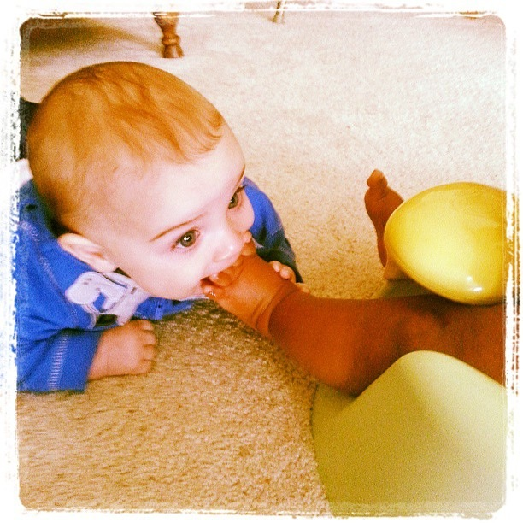
6. The family’s priorities, needs and interests are addressed most appropriately by a primary provider who represents and receives team and community support.
7. Interventions with young children and family members must be based on explicit principles, validated practices, best available research, and relevant laws and regulations.
Workgroup on Principles and Practices in Natural Environments, OSEP TA Community of Practice: Part C Settings. (2008, March). Agreed upon mission and key principles for providing early intervention services in natural environments. Retrieved from
http://ectacenter.org/~pdfs/topics/families/Finalmissionandprinciples3_11_08.pdf
Notes:
6. Primary provider has support in literature _ Sloper, Turner (1992) – Huge study in UK: Families with multiple providers had increased parental stress, UNMET NEEDS (every=one thinks someone elas is doing it), Confusion, General Lack of Coordination of services. 2004 Dunst & Bruder – Finding from national Study on familes reporting og the helpfullness of EI: THE MORE PROVIDERS, the LESS HELPFUL EI services were rated by parents! But PSP does not mean one person: “Every child, every family gets a TEAM!” ( Sheldon, Rush 2014)
7. Self – explanatory. These principles are based on best available research.
WHY – were these principles developed???????
The 7 Key Principles were based on RESEARCH, BEST PRACTICE RECOMMENDATIONS, FEDERAL LAW.

Slide 22
Primary service provider approach to teaming
Every child, every family has a full team
One interventionist functions as the primary support for the family
Strengthens parents confidence and competence in promoting child learning and development
Supports parents competence in obtaining desired supports and resources
Shelden, M. L., Rush D. D. (2013) The Early Intervention Teaming handbook: The Primary Service Provider Approach.
Baltimore, MD: Paul H. Brookes Co.
Notes:
Misconception is that PSP leads to a family/child having only one interventionist. EVERY family, EVERY child has a TEAM!
One person is the primary support for the family. Other team members are MEETING REGULARLY to support the PSP and doing as many joint visit as necessary (based on PSP needs).

Slide 23
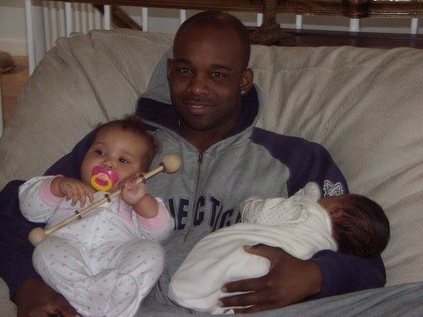
Research
Primary Service Provider
National report on helpfulness of early intervention:
96% of the time parents with one provider rated him or her as helpful
77 % of the time parents with two providers rated them as helpful
69 % of the time parents with three or more providers rated them as helpful
Bruder M.B. & Dunst, C.J. (2004)
www.uconnucedd.org/pdfs/projects/rtc/rtc_outcome_interview_data_report_10_15_04.pdf
Accessed May 15, 2015
Notes:
Bruder & Dunst National Survey/Report. 2008. Helpfulness of EI.
Families that rated interventionist(s) as helpful:
96 % - with 1 interventionist
77% - with 2
69% - with 3

Slide 24
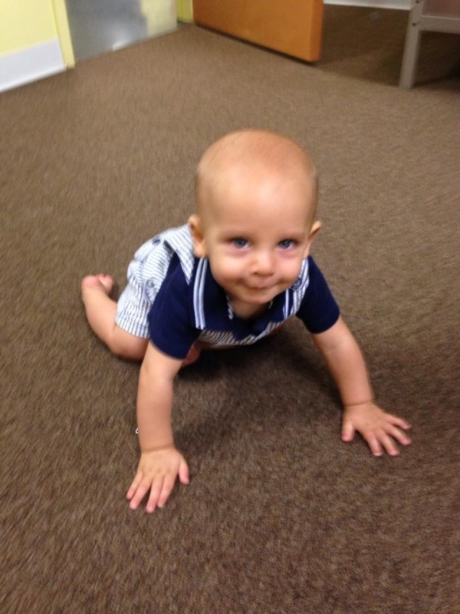
More research on PSP
190 infants and families receiving 1 year of Early Intervention services reported:
less parental stress with one providers vs. multiple providers
the developmental outcomes for these infants was also better when served by a single provider vs. multiple providers(1)
Review of Literature
Families with multiple providers:
increased parental stress and confusion
multiple providers resulted in a significant number of families having unmet needs, especially for children with severe disabilities(2)
Shonkoff, J.P., Hauser-Cram, P., Krauss, M.W., & Upshur, C.C. (1992) Development of Infants With Disabilities and Their Families: Implications for Theory and Service Delivery. Monographs of the Society for Research and Child Development, 57(6), 1-163
Sloper, P., & Turner, S. (1992). Service Needs of Families of Children With Severe Physical Disability. Child: Care, Health and Development, 18(5), 259-282
Notes:
Jack Shonkoff. 1992. Looked at families with infants with disabilities. Investigating factors that impacted theory and service delivery.
(2) Sloper & Turner. 1992. Review of Literature. Looking at service needs families of children with severe disabilities.

Slide 25
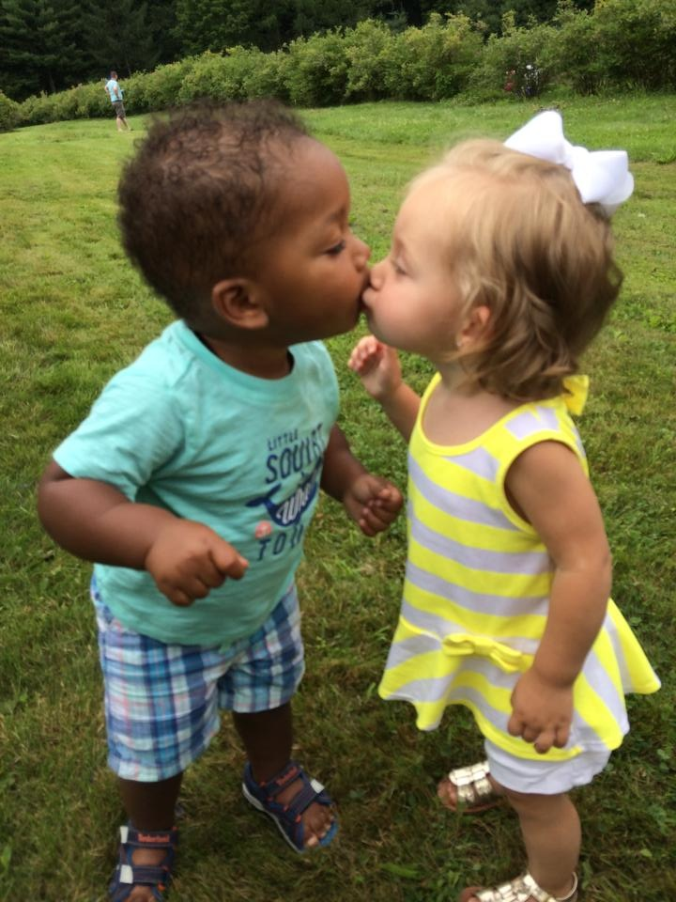
Pilot Study
Rush & Shelden
Experimental group of children and families: Primary Service Provider teaming, NLE’s & coaching interaction style
Control group - multiple independent providers
PSP/coaching families:
  received less service hours
  met IFSP outcomes more often
Children in both groups showed developmental progress
No differences in the amount of progress noted between the groups.
Shelden, M.L., Rush D.D. (2013) A Pilot Study of the Use of Geographically Based Early Intervention Teams Using a Primary Service Provider Approach to Teaming in The Early Intervention Teaming handbook: The Primary Service Provider Approach. Baltimore, MD: Paul H. Brookes Co. (p. 40)
Notes:
Pilot Study. Rush & Shelden. Noted in their Early Intervention Teaming Handbook, 2013. Small study – 20 children in each group. Data collected for developmental outcomes for 6 – 46 weeks, mean of 20.8 weeks.

Slide 26

Natural Learning Environment Practices
Coaching as a Style of Interaction
Primary Service Provider Approach to Teaming
EVERY FAMILY, EVERY CHILD, HAS A TEAM
Notes:
Birth to Three Practices:
Based on our best available research on how children and families learn
Encompass 3 main practices – NLE practices, Coaching as a style of interaction, PSP approach to teaming.
Builds the parent’s Competence & Confidence in meeting their child’s needs and providing opportunities (strategies) for them to learn
Every Family, Every Child has a team!

Slide 27

Our Role: Supporting Parents and Caregivers
Shares knowledge and resources with a child’s key caregivers through adult-to-adult relationships
Family members are supported in their day-to-day responsibilities of caring for their child
Hanft, B. (April, 2010). Enhancing Services in Natural Environments [webinar]. Retrieved from http://www.ectacenter.org/~pdfs/calls/2004/partcsettings/hanft.pdf
Notes:
In this new paradigm, practitioners’ roles have shifted from the practitioner as the expert to the practitioner as one who shares knowledge and resources with a child’s key caregivers through adult-to-adult relationships in order to support family members in their day-to-day responsibilities of caring for their child.
Trainer notes:
At this point in the presentation, please pause to check in with your audience. It is recommended that you ask 1-2 relevant reflection questions before moving on to the next section of the presentation. The questions below are designed to assess participants’ knowledge, skills and attitude related to the content of the presentation. The trainer should select questions from the options listed below based upon the particular audience and their comments and questions to this point, and what may be needed in order to support the participants’ understanding and application of the material.
Potential questions to ask:
“Does this information about supporting families resonate with you?”
“What are you already doing to support families?”
“In what ways, if any, might you need to change your own practice?”
“What additional supports and resources might you need?”
“Do you have any questions?”

Slide 28


Natural Learning Environments
Are:
Natural learning opportunities in everyday family life
Notes:
Natural Learning Environment Practice includes:
working with families in their everyday activities
starting with the activity and determining the learning opportunities present ( in ALL areas of development)
Building competence in the caregiver to be able to use strategies during those activities
That then leads to skill development and increased participation for the child

Slide 29
Natural Learning Environments
START with focus on the
ACTIVITY
Natural activities,
routines,
settings
Learning opportunities:
In ALL domains
Desired skills and behaviors
Notes:
SEE ACTIVITY SHEET. 4 Corners Activity: Bath, Dinner, Grocery shopping, Diaper Change/Dressing. Activity – Write on wall paper/easel:
1. What are some Learning Opportunities in the various activities?
2. What skill or behavior could that learning opportunity target?
EXAMPLE: BATHTIME
Learning Opportunities: Skill
Splashing: two-hand use, learning to handle sensory input from the water
Sitting in tub: sitting balance, tummy/pelvic control, head control
Talking with child: learning new words, imitating words
Making choices: increase communication
Being engaged with parent/sibling: Interpersonal skills
Washing: increase self-help
Dump and Fill: FM, cognitive

Slide 30
Natural Learning environments
Three areas of focus:
Activity Settings and Family routines
Caregiver Responsiveness
Child Interests
Notes:
NLE practices look at the interaction and interdependency of 3 areas:
Child Interests – critical for learning
Caregiver Responsiveness – we build competence through coaching interactions
Activity Setting & Family Routines – drive learning opportunities that lead to skill development.

Slide 31
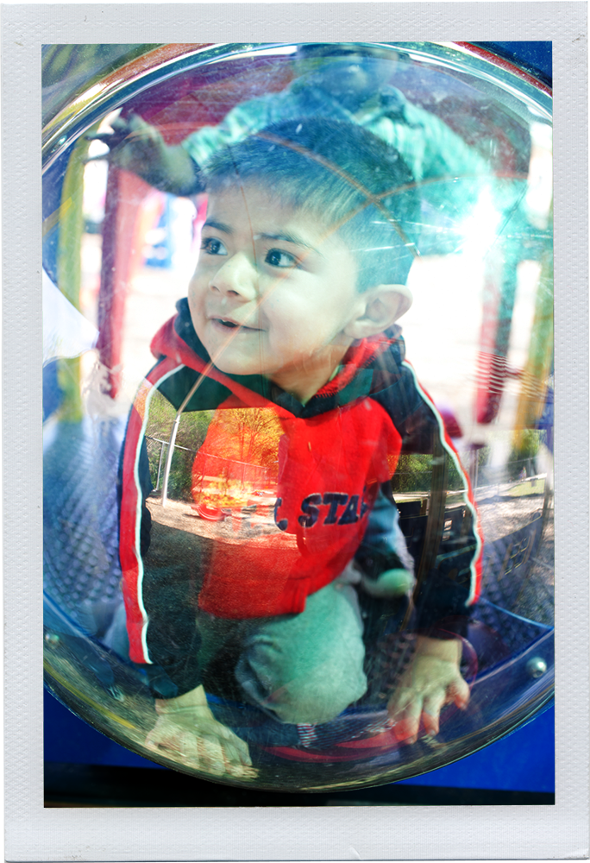
Research:
How Children Learn
Natural learning opportunities
Every day routines and activities of children and families
Within family and community life
Dunst, C. J., Bruder, M. B., Trivette, C. M., Raab, M., & McLean, M. (2001). Natural learning opportunities for infants, toddlers, and preschoolers. Young Exceptional Children, 4(3), 18-25. (Erratum in Young Exceptional Children, 4(4), 25)
Shelden, M. L., & Rush, D. D. (2001). The ten myths about providing early intervention services in natural environments. Infants & Young Children, 14(1), 1-13.
Notes:
So, WHY NLE practices? Let’s begin with how children learn. Expert researchers in the field of early childhood have identified that children learn best when they are participating in naturally occurring learning opportunities that are a part of everyday routines and activities within the real life context of their families and other children they know.

Slide 32

Learning Requires Engagement
“…amount of time children spend interacting appropriately with their environment.”
McWilliam, R.A. (April, 2010). Enhancing Services in Natural Environments [webinar]. Retrieved from
http://www.ectacenter.org/~pdfs/calls/2004/partcsettings/mcwilliam.pdf
Notes:
The more a child is engaged, the more positive the outcomes will be in areas such as:
Behavior,
Developmental progress,
Communication,
Problem solving, and
Interacting with others.

Slide 33
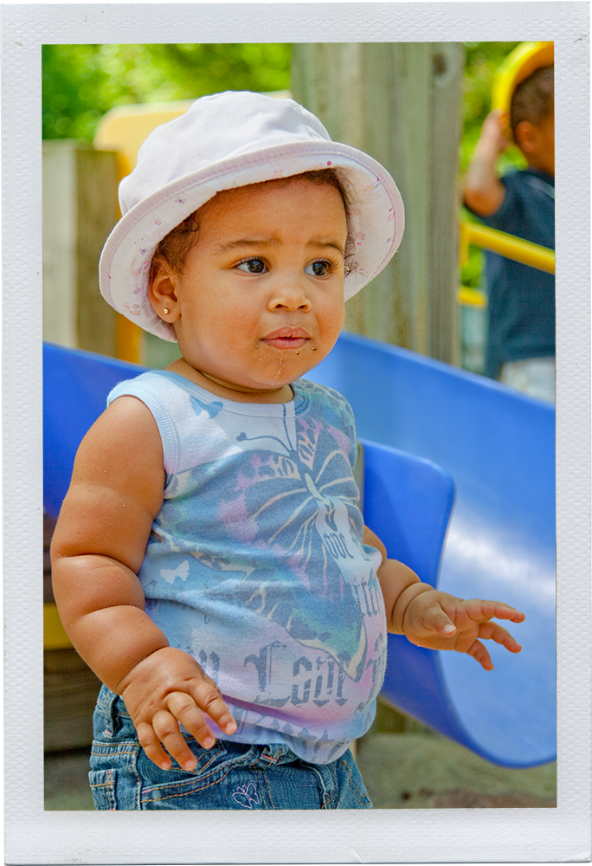
Children Learn through Incredible Amounts of Practice!
The amount of a toddler’s experience with walking is the only predictor of improved proficiency
Toddlers practice walking for more than 6 hours daily
Average 500 – 1500 steps per hour
9000 steps per day (length of 29 football fields!)
Adolph, K. E., Vereijken, B., & Shrout, P. E. (2003). What Changes in Infant Walking and Why. Child Development, 74(2), 475-97.
Notes:
Overall, children learn new skills through incredible amounts of practice. Let’s take ‘walking’ as an example. The amount of experience a toddler has with walking (not muscle strength) is the only significant predictor of improved proficiency with walking. When a toddler first learns to walk, they typically practice keeping balance in upright stance and locomotion for more than six accumulated hours per day and they average between 500 and 1500 walking steps per hour. By the end of a day, a child may have taken 9,000 walking steps and traveled the length of 29 football fields. All of this practice leads to mastery. Keep in mind that children with disabilities will need more practice to master walking.

Slide 34
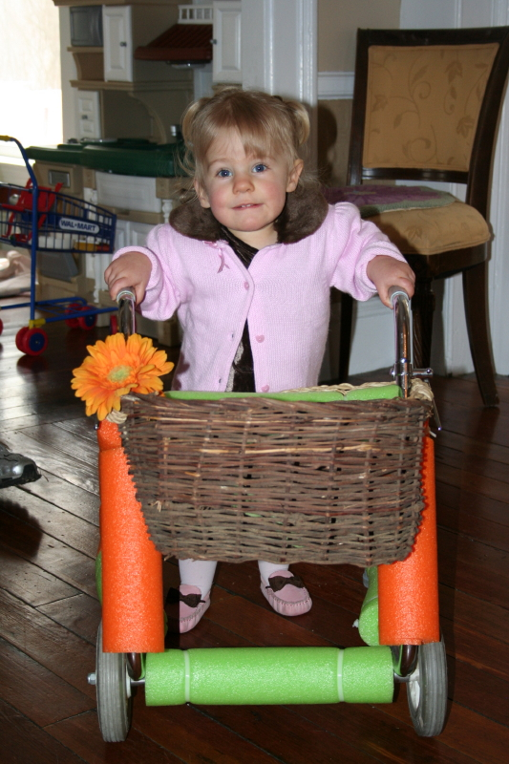
Mastery
Mastery of functional skills occurs through high-frequency, naturally occurring activities in a variety of settings that are consistent with family and community life.
Shelden,M.L., & Rush,D.D. (2001). The ten myths about providing early intervention services in natural environments..Infants & Young Children,14(1),1-13.
Dunst, C. J., Bruder, M. B., Trivette, C. M., Hamby, D., Raab, M., & McLean, M. (2001). Characteristics and consequences of everyday natural learning opportunities. Topics in Early Childhood Special Education, 21(2), 68-92.
Dunst, C. J., Bruder, M. B., Trivette, C. M., Raab, M., & McLean, M. (2001). Natural learning opportunities for infants, toddlers, and preschoolers. Young Exceptional Children, 4(3), 18-25. (Erratum in Young Exceptional Children, 4(4), 25)
Dunst, C. J., Hamby, D., Trivette, C. M., Raab, M., & Bruder, M. B. (2002). Young children's participation in everyday family and community activity. Psychological Reports, 91, 875-897.
Notes:
In summary, mastery occurs through frequent repetition of skills used in naturally occurring, developmentally appropriate activities across various settings.

Slide 35
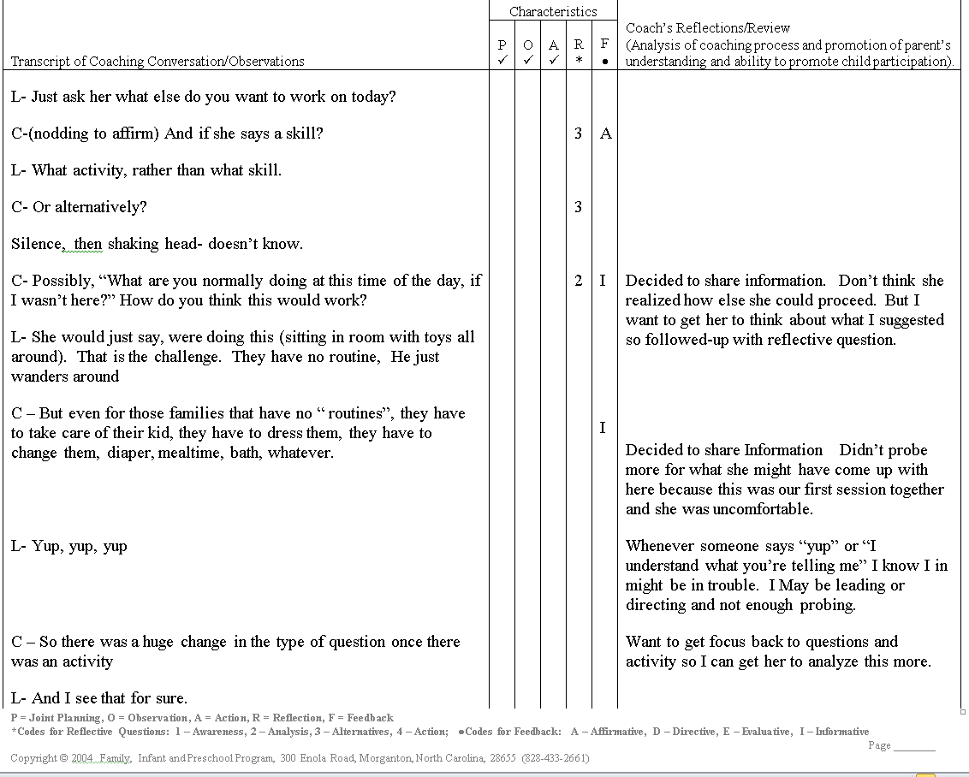
Becoming Skilled in coaching interactions
It’s Hard work!!!
Coaching involves a rigorous training and support process over at least 6 months to reach fidelity
Notes:
Using Coaching Logs to record transcript of sessions with families. Coding and Reflecting on logs. Reviewing logs with Master Coach.

Slide 36
Natural Learning Environments
Best opportunities for success
Increase caregiver competence
Activities happen:
  all day
  everyday
  during the family's regular activities
NOT
“therapy” working directly with child with little carry though in everyday activities
Activities lead to
Learning Opportunities
that lead to
Skill Development
NOT
starting with isolated skills and embedding them in routines
Notes:
This is really getting deeper in NLE practice.

Slide 37
Coaching is NOT Couching!
MYTH
TRUTH
It’s all talking
Hands off!
It only works with some families
Practitioner can not share expertise
The emphasis is action & practice during visit
Coaching is as hands-on as it needs to be
It is family-centered practice. Works for all.
Practitioner first finds out what the parent knows and their ideas before sharing information
Rush D. D., Shelden, M. L. (2011) The Early Childhood Coaching Handbook. Baltimore, MD: Paul H. Brookes Co
Notes:
Again, Coaching in NOT a MODEL. It is a style of interaction ( bedside manner).

Slide 38
Transition
May include referral to SDE Part B services (data sent to LEA at 2.5 y/o)
Assistance transitioning to community supports (preschool, library group, play groups, etc.)
Reunification (assisting with consistency across living situations)
It is individualized to family’s identified needs and preferences

Slide 39
For More Information
CT. Birth to Three Website http://www.birth23.org/aboutb23/lookslike/
Mission/Key Principles http://www.ectacenter.org/~pdfs/topics/families/Finalmissionandprinciples3_11_08.pdf
7 Key Principles: Looks like, Doesn’t Look Like
http://www.nectac.org/~pdfs/topics/families/Principles_LooksLike_DoesntLookLike3_11_08.pdf
Shelden, M. L., Rush D. D. (2011) The Early Intervention Teaming handbook: The Primary Service Provider Approach. Baltimore, MD: Paul H. Brookes Co.
Rush D. D., Shelden, M. L. (2011) The Early Childhood Coaching Handbook. Baltimore, MD: Paul H. Brookes Co

Slide 40

THANK YOU!

