Slide 1
Implicit Bias Training November 13th, 2020
Notes:
Welcome participants. Trainers to introduce themselves.
The trainer will explain that this training was taken from the Commission on Racial & Ethnic Disparity in the Criminal Justice System- Institute of Municipal and Regional Policy, Everyday Democracy and DCF.

Slide 2
Navigating the Virtual Platform
Log out of VDI/VPN During the Training
Notes:
Review slide to orient participants to Microsoft Teams and considerations for virtual learning.
Starting from left to right- video/camera, mute/microphone, share screen , other options, raise hand, chatbot, participants and end meeting
Remind participants they need to be out of VDI/VPN in order to prevent getting “kick out” of the training due to bandwidth issues

Slide 3
Pre-Surveys & Post Survey
Harvard Project Implicit Participants will click on the below link and select Project Implicit Featured Task Then click on "Knowing this, I wish to proceed with the: "How we think about race/ethnicity" And finally select the Race IAT: https://implicit.harvard.edu/implicit/selectatest.html ​
Pre -Survey https://forms.office.com/Pages/ResponsePage.aspx?id=-nyLEd2juUiwJjH_abtzi0s8RACPwuJLovtgPPSUTqZUNjBGMFpSNkhVQjRWS1ZEWkgySlZDN1hZMi4u ​
In two weeks, you will receive the Post Survey, please complete it. The data gathered from the Pre & Post Surveys will be submitted into a study and presented to the DCF Institutional Review Board.
Notes:
****These surveys should be sent to the participants before the training. ***** This is the responsibility of the trainer******
Implicit Bias Trainers will be responsible for sending out these surveys. ​
Remind participants that these should have been completed prior to class.
The trainer will also explain to the participants that they will receive a post survey within two weeks from today’s training. The Academy is trying to determine if this training made an impact in the work we do and how we connect to our peers within DCF.
In two months, all supervisory and management staff will receive an impact survey- this survey will focus on the decision making within DCF to determine if this training has made an impact with reducing the number of children of color coming into care.
All of date collected from these survey’s will be used in a research will be reviewed to the IRB. The DCF IRB is responsible for reviewing and approving research involving clients and staff prior to the initiation of research and through continuing review and monitoring of approved studies. The purpose of an IRB review is to ensure that studies are being conducted in accordance with the ethical principles of autonomy, beneficence and justice as set forth in the The Belmont Report, and in compliance with federal regulations and internal policies.

Slide 4
Introduction and Goal:
Implicit bias refers to the attitudes or stereotypes that affect our understanding, actions, and decisions in an unconscious manner. These biases, which encompass both favorable and unfavorable assessments, are activated involuntarily and without an individual’s awareness or intentional control.
The goal of this training is to learn about implicit bias and to measure our implicit bias based on race, religion, gender and a vast array of other areas.
In addition to understanding our blind spots, more discussions must take place in order to influence our bias. In order for implicit bias training to be effective, it has to be done frequently.
Notes:
Introduce topic of implicit bias. No need to spend too much time on the definition as later slides will address this.
Much of the focus for this training is on racial bias, how we identify our own and address it in our work.

Slide 5
Learning Objectives
Define implicit bias and discuss examples from participants' real-life experiences
Review the science of implicit bias
Discuss factors that might be leading to implicit bias
Discuss the importance and value of inclusivity in the workplace
Discuss implicit bias and its impact on decision making
Discuss the Implicit Association Tool (IAT) and how it can be used for self-reflection and a measure for effective decision making
Share examples of how implicit bias shows up in our systems
Discuss the problems that can be caused by implicit bias in the community
Analyze how bias may impact your every day
Notes:
Trainers may deliver and present this training to diverse audiences.
Articulate that this training is LIMITED in scope to address identity, social groups, implicit bias and impact.
Other areas of focus are D&I, workforce development, leadership development, programs and services, community engagement, strategic planning, and systems change.
While we are NOT exploring specific strategies or systems-level efforts, there are programs and tools as well as strategies being explored to mitigate implicit bias (Bias Interrupter Toolkit)
Review objectives of the training.

Slide 6
Making Connections
Introductions/Who We Are
Overview of the Training
Our Hopes and Concerns for this Dialogue
Guidelines for this Dialogue:
Be Respectful
Share “air time” – ELMO
On person speaks at a time. Speak for yourself, not others
If you are offended or upset, say so and say why
Personal stories stay in the dialogue unless it is decided these stories can be shared with others outside the room
Notes:
Have participants introduce themselves, request that they unmute mics and cameras when they are introducing themselves. (may ask what role they are in and/or how long they have worked at DCF).
Indicate that the training will address the objectives noted in the previous slide over the course of the next 3 hours. This training frequently brings about a lot of conversation which is welcomed and encouraged as we explore this topic which has significant impact on our work.
Ask group to share any hopes or concerns they may have for the dialogue.
Review guidelines
Be Respectful – what does this look like in action, how will we know we are being respectful?
Share “air time” – ELMO (Enough Let’s Move On) the trainer and/or participants can use this if they feel like the conversation is stalled in one place
On person speaks at a time. Speak for yourself, not others
If you are offended or upset, say so and say why
Personal stories stay in the dialogue unless it is decided these stories can be shared with others outside the room
Suggest everyone speak from their own personal experiences and not generalize for entire populations.
Trainer will ask if there are any other guidelines that need to be added.
Seek agreement from the group about these guidelines.

Slide 7
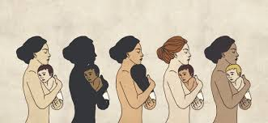
DCF Racial and Ethnic Categories
The federal categories for racial and ethnic identify provides “a Common Language to Promote Uniformity and Comparability for data on race and ethnicity for the population Groups”.
For today’s training DCF will utilize this language:
- Children / People of Color
-American Indian or Alaska Native
-Asian
-Black or African American
-Native Hawaiian or other Pacific islander
-White
Ethnic Category:
-Hispanic or Latino
Notes:
Explain the following are geographically based descriptions of each federal category which may assist in more accurate reporting of racial and ethnic identity and it Refers to the world map-The trainer will explain the language used in this class is to match the language DCF uses pertaining to our data (next slide).
-American Indian or Alaska Native: A person having origins in any of the original peoples of North or South America (including Central America) and who maintains tribal affiliation or community attachment
-Asian: A person having origins in any of the original peoples from the Far East, Southeast Asia, or Indian subcontinent including, Cambodia, China, India, Japan, Korea, Malaysia, Pakistan, the Philippine Islands Thailand and Vietnam.
-Black or African American – A person having origins in any of the black racial groups of Africa
-Native Hawaiian or other Pacific islander: A person having origins in any of the original peoples of Hawaii, Guam, Samoan and other Pacific Islands
-White: A person having origins in any of the other peoples of Europe, the Middle East and North Africa
Ethnic Category:
Hispanic or Latino : Of Mexican, Puerto Rican, Cuban, Central or South American origin; or a person of the other Spanish cultural origin regardless of race. Whether or not a person is Hispanic or Latino is determined by how they define themselves or by how others define them
Seek agreement from the group on the use of these terms. Encourage individuals to identify themselves how they are most comfortable.

Slide 8
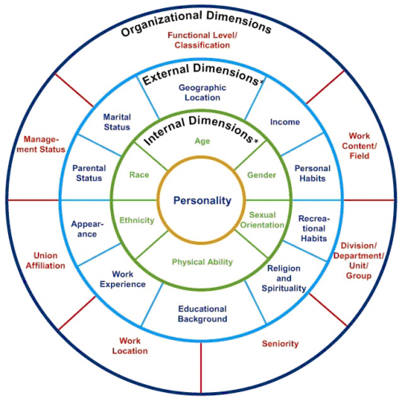
Identity
Image from http://www.uscg.mil/diversity/Diversity_101.asp credited to: Health Resources and Services Administration
Notes:
Relate the various dimensions of diversity/identity.
Internal = Social Identities – most apparent or obvious to others, often with little opportunity to change (race, gender, sexual orientation, physical ability, ethnicity, age)
External = Personal Identities – sometimes apparent, but often not but assumed; can be changed over life course (geographic location, class/income, religion, work/career, appearance, education, familial status)
Organizational = Operational Identities – opportunities or privileges that influence perceptions by others (both work/career and community)
For those not referencing their training material, this is very hard to read. It may help to list each of the identities for the audience.
Note that identity, positive and negative, can be internalized by individuals so individuals may not readily share or claim an identity.

Slide 9
IMPLICIT BIAS
WHAT DOES IT MEAN?
Notes:
Ask if anyone can define implicit bias in their own words.

Slide 10
Implicit Bias Defined
Implicit bias refers to the attitudes that affect our understanding, actions, and decisions in an unconscious manner. These biases can be both favorable and unfavorable, are activated involuntarily and without an individual’s awareness or intentional control.
Notes:
The Kirwan Institute for the Study of Race and Ethnicity-The Ohio State University
http://kirwaninstitute.osu.edu/research/understanding-implicit-bias/
The implicit associations we harbor in our subconscious cause us to have feelings and attitudes about other people based on characteristics such as race, ethnicity, age, and appearance. These associations develop over the course of a lifetime beginning at a very early age through exposure to direct and indirect messages. In addition to early life experiences, the media and news programming are often-cited origins of implicit associations.
Some examples of bias are:
Resumes with ethnic sounding names pushed down in the selection for interviews.
Asian candidates given priority positions requiring math and science.
Women more frequently interrupted in business meetings.
Telling a minority that they are articulate.
Looking to remove a child because of their race.
Examples were found in “Unconscious bias and Implicit Bias” The Underlying Platform of Discrimination in the Workplace. https://insightedcationsystems.com/unconscious-bias-implicit-bias/

Slide 11
Consequences of Implicit Bias
Negative impact of bias within the workplace are:
Marginalizes and under-utilizes talent
Impairs recruitment and retention
Erodes an individual’s performance
Stifles innovation and growth
Inhibits teamwork and collaboration
Notes:
Suggested engagement opportunity: Ask group what they think are possible consequences of implicit bias in the workplace. Slide is animated (bullet points will appear after a second click, click once feedback from the group is solicited)
Negative impact of bias within the workplace are:
Marginalizes and under-utilizes talent
Impairs recruitment and retention
Erodes an individual’s performance
Stifles innovation and growth
Inhibits teamwork and collaboration
Examples of consequences were found in “Unconscious bias and Implicit Bias” The Underlying Platform of Discrimination in the Workplace. https://insightedcationsystems.com/unconscious-bias-implicit-bias/

Slide 12
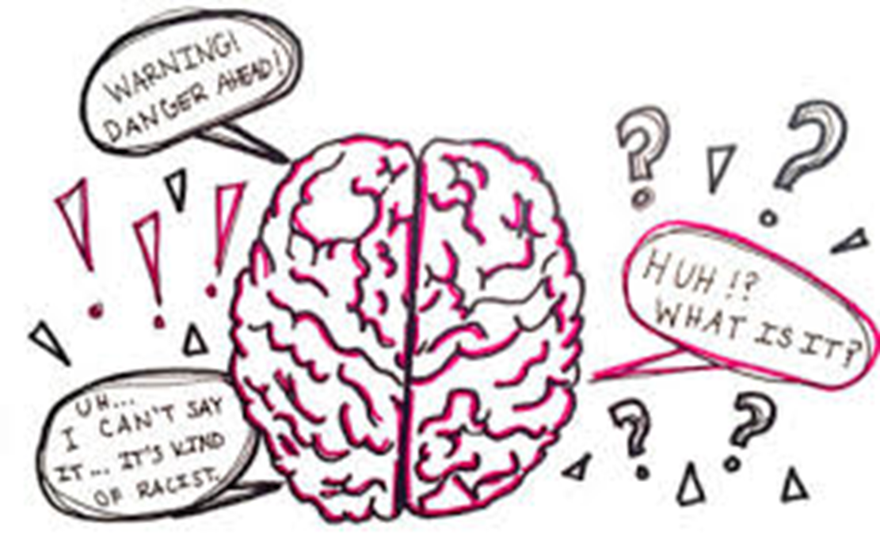
IMPLICIT BIAS AND THE BRAIN
Notes:
Connect brain overload, processing function and time, resulting in rapid responses and reactions based on ways our brains categorize information, resulting in bias.

Slide 13
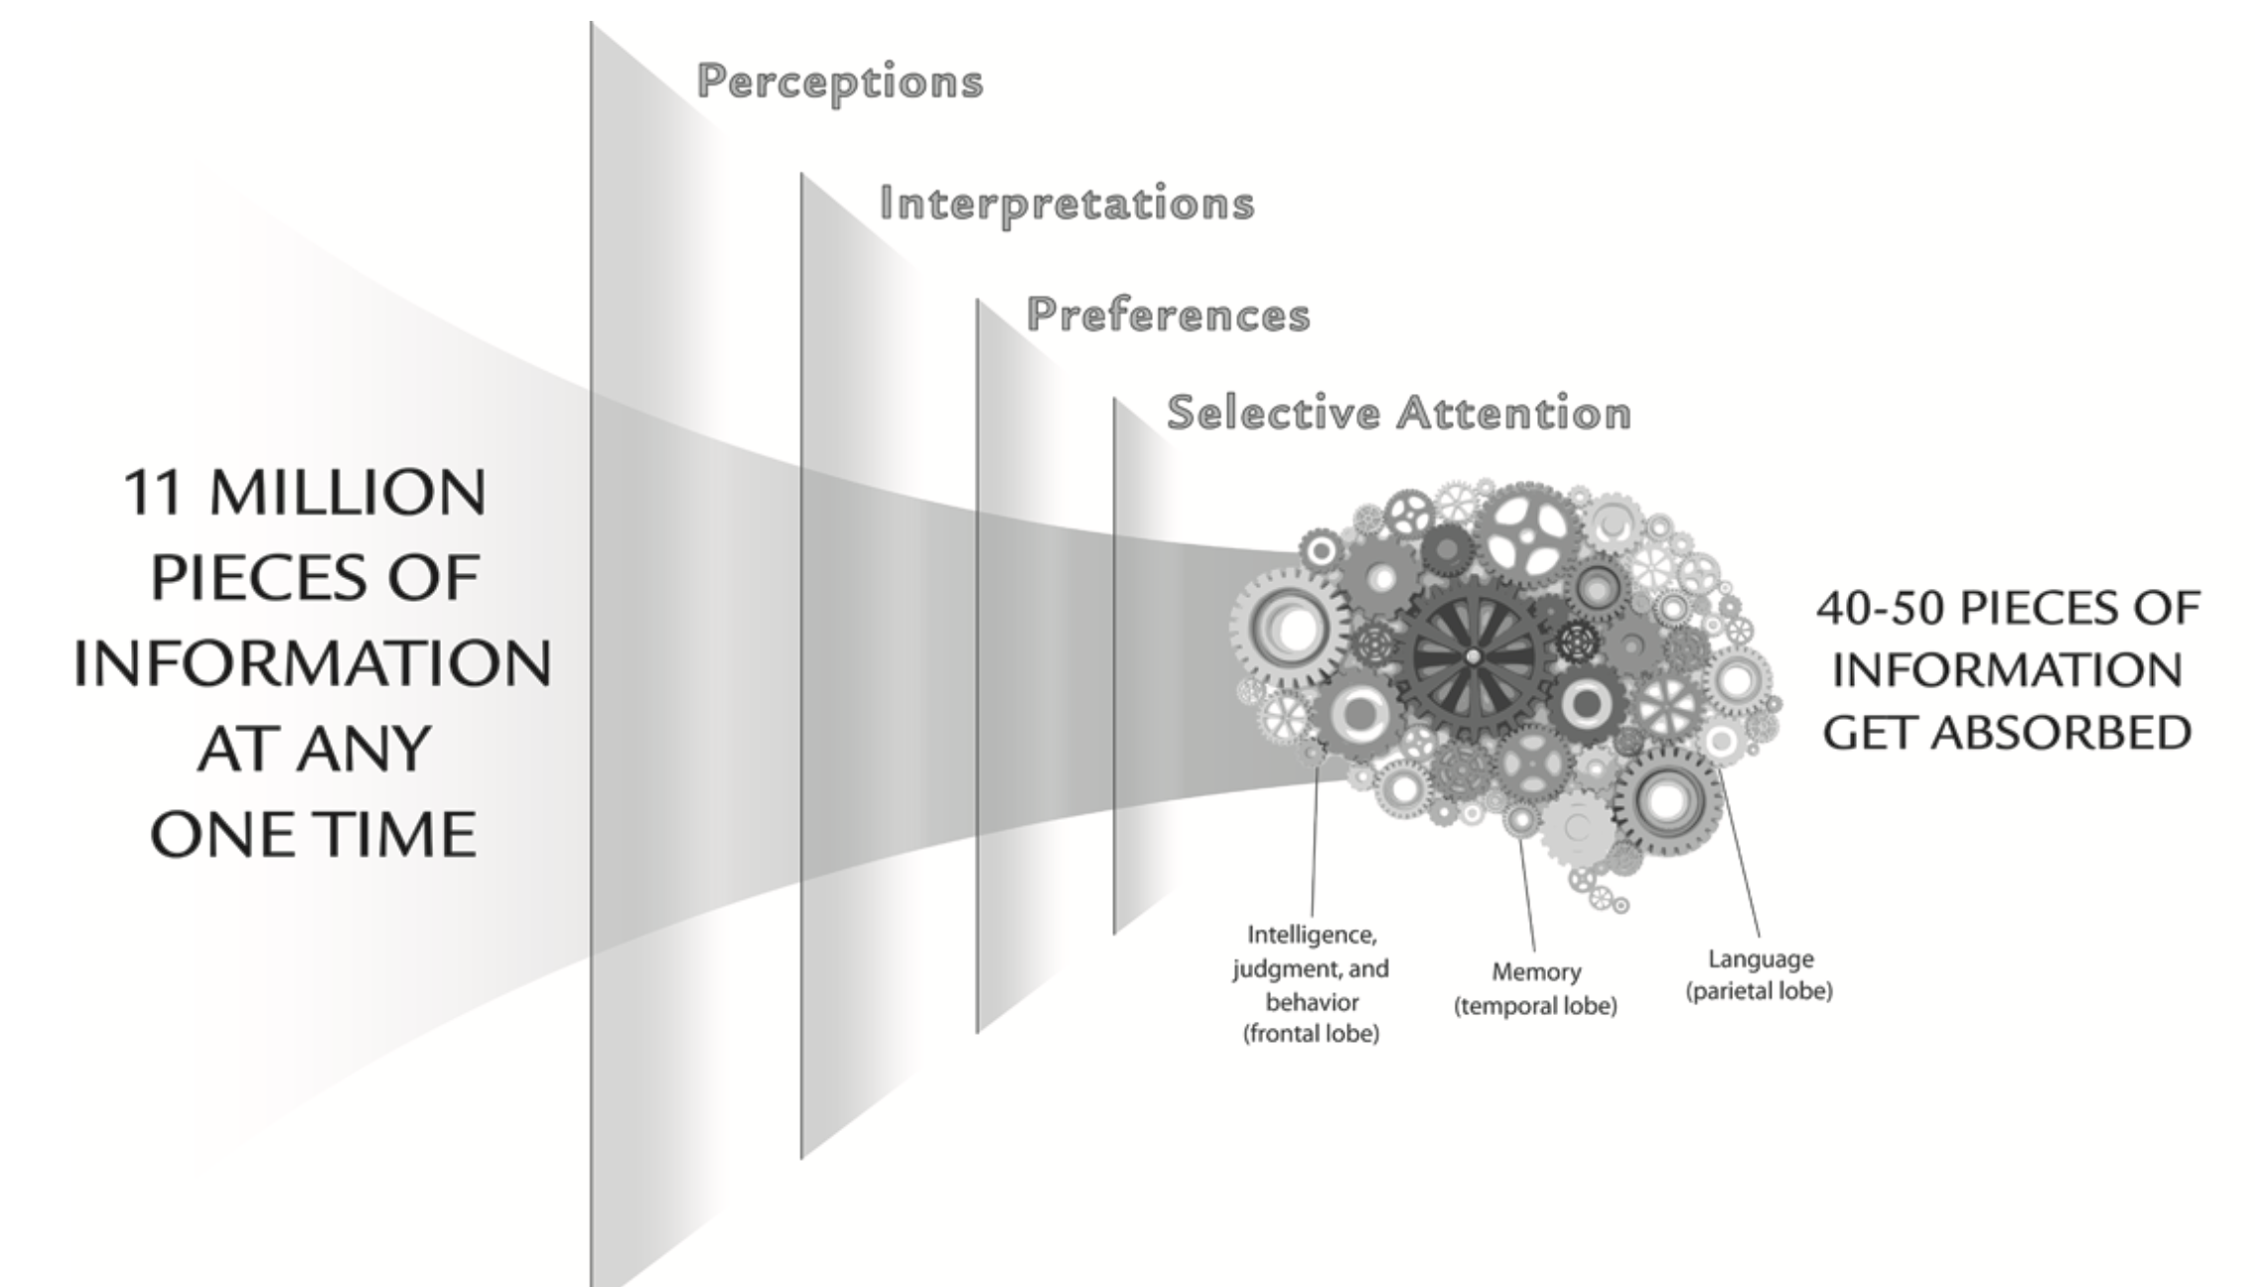
Information Overload
Notes:
Source: Unconscious Bias Workbook, Cook Ross, http://www.cookross.com/docs/UnconsciousBiasWorkbookSample.pdf
TALKING POINTS:
We are constantly inundated with information. At any one time we are receiving 11 million pieces of information. That information is being filtered, sorted, and categorized.
The process is influenced by our perceptions, experiences, preferences, interpretations of the information, and our selective attention to details. All of this happens subconsciously. When all of this information finally passes through this mental strainer, only 40-50 pieces are absorbed.
Without this process, we would be overwhelmed and at times paralyzed from making decisions and acting.
Seeing patterns and sorting information allows us to make judgments more quickly.
Can give examples; sorting colors and shapes, recognizing people, driving to and from work. Low mental energy – our brain at work.
Biased, Eberhardt, 2016 – pg 24 “…it is the universal function of the brain that allows us to organize and manage the overload of stimuli that constantly bombard us. …brings coherence to a chaotic world; it helps our brains make judgments more quickly and efficiently by instinctively relying on patterns that seem predictable.”
“A distorting lens that’s a product of both the architecture of our brain and the disparities in our society.”

Slide 14
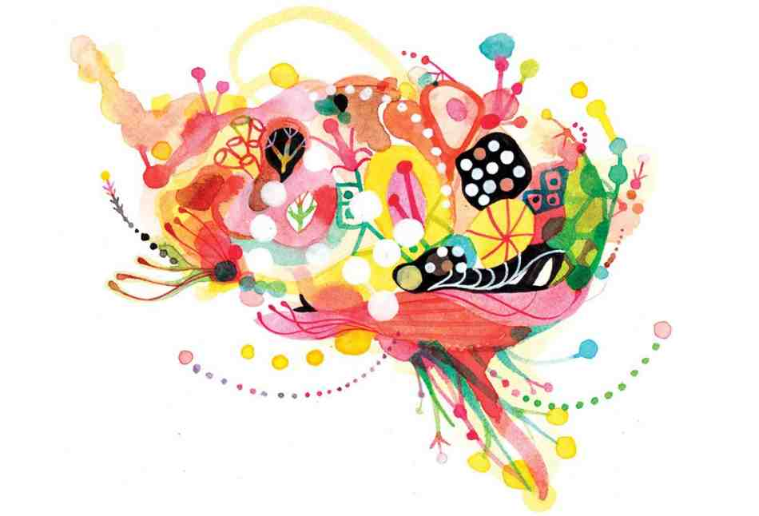
Schemas
Pattern of thought or behavior that organizes categories of information and creates relationships.
Processing objects, behaviors, situations and people; allowing quick response and reactions.
Notes:
Review definition of schema. Next slide will play a video explaining this concept in more detail.
Source: Jerry Kang, Implicit Bias: A Primer for State Courts (National Center for State Courts, 2009).
https://www.ncsc.org/~/media/Files/PDF/Topics/Gender%20and%20Racial%20Fairness/kangIBprimer.ashx
See also https://www.youtube.com/watch?v=OQGIgohunVw&feature=youtu.be
Image source
https://nccc.georgetown.edu/bias/module-1/2.php

Slide 15
Schemas
Notes:
Video runs 3:12 seconds.
Play video and seek feedback from group.
https://www.youtube.com/watch?v=OQGIgohunVw

Slide 16
HOW DO SCHEMAS RELATE TO STEREOTYPING…
SCHEMAS’ function is to help us make sense of the complex world of information that we live in.
They also enable us to make generalizations about situations, people and places. Stereotypes are an example of a social schema and how we can generalize about groups of people to save our cognitive energy.
Notes:
Along with the existence of schema, another central claim of schema theory is that their function is to help us make sense of the complex world of information that we live in. They also enable us to make generalizations about situations, people and places. Stereotypes are an example of a social schema and how we can generalize about groups of people to save our cognitive energy.
EVEN NEW INFORMATION CAN STRENGTHEN STEREOTYPES
If we have an existing stereotype (social schema) about a group of people, we use this schema when we’re processing new information and we might tend to focus only on details that are consistent with our schema, since this is cognitively easier. This means that we might focus on and remember details of someone that are consistent with our existing stereotype, which is how stereotypes might be reinforced.
https://www.themantic-education.com/ibpsych/2017/11/29/schema-theory-a-summary/
Thematic Education’s IB Psychology, A Student’s Guide, Travis Dixon

Slide 17
Schemas
Notes:
Unpacking schemas can reveal biases and stereotypes that if left unchecked could result in discriminatory behavior.
Source: Jerry Kang, Implicit Bias: APrimer for State Courts (National Center for State Courts, 2009). https://www.ncsc.org/~/media/Files/PDF/Topics/Gender%20and%20Racial%20Fairness/kangIBprimer.ashx
See also https://www.youtube.com/watch?v=OQGIgohunVw&feature=youtu.be
Social schemas lead to stereotypes and some also reinforce stereotypes. Implicit bias may form as a result of exposure to persistent stereotypes.
One way schemas can influence cognition is that they can affect our ability to comprehend new information. When we’re exposed to new information we relate it to our existing knowledge (our schemas) and this can improve our comprehension of that information (as seen in Bransford and Johnson’s study).
This process of relating new information to existing schema can also influence our processing of new information and can lead to confirmation bias. If we have an existing stereotype (social schema) about a group of people, we use this schema when we’re processing new information and we might tend to focus only on details that are consistent with our schema, since this is cognitively easier. This means that we might focus on and remember details of someone that are consistent with our existing stereotype, which is how stereotypes might be reinforced.
https://www.themantic-education.com/ibpsych/2017/11/29/schema-theory-a-summary/
Thematic Education’s IB Psychology, A Student’s Guide, Travis Dixon
Image source https://nccc.georgetown.edu/bias/module-1/2.php

Slide 18
Aoccdrnig to rscheearch at Cmabrigde Uinervtisy, it doesn't mttaer in waht oredr the ltteers in a wrod are, the olny iprmoetnt tihng is taht the frist and lsat ltteer be at the rghit pclae. The rset can be a toatl mses and you can sitll raed it wouthit porbelm. Tihs is bcuseae the huamn mnid deos not raed ervey lteter by istlef, but the wrod as a wlohe.
Notes:
Instruct participants to READ ALOUD altogether.
Virtual Version – ask for a volunteer to read this aloud
Connect our ability to process information quickly (mis-spelled words) by associating first and last letters, similarly to how our schemas for better or worse help us process situations and make decisions inherently influenced by bias and stereotypes.

Slide 19
STROOP TEST
DO YOU KNOW YOUR COLORS??
Notes:
Ask for a volunteer to play a game about colors.
Trainer will need a stopwatch (or other timer for this activity – consider using stopwatch on cell phone)

Slide 20
#1 | #2 | #3
SLB | CFLTK | CFLTK
SPRND | HLMG | CFLTK
SLB | SPRND | SLB
SPRND | HLMG | CFLTK
Notes:
Stroop Test – Ask volunteer to read aloud by columns 1, 2, 3 from top to bottom by COLOR of letters (no need to identify the column #)
Time how long it takes for them to complete the task and write this down.
For reference (but does not need to be explicitly discussed at the start of the activity)
John Ridley Stroop, American psychologist
www.whatispsychology.biz
The original paper has been one of the most cited papers in the history of experimental psychology, leading to more than 700 Stroop-related articles in literature. The effect has been used to create a psychological test (Stroop test) that is widely used in clinical practice and investigation.
https://en.wikipedia.org/wiki/Stroop_effect
In psychology, the Stroop effect is a demonstration of interference in the reaction timeof a task.
When the name of a color (e.g., "blue", "green", or "red") is printed in a color which is not denoted by the name (i.e., the word "red" printed in blue ink instead of red ink), naming the color of the word takes longer and is more prone to errors than when the color of the ink matches the name of the color.
The effect is named after John Ridley Stroop, who first published the effect in English in 1935.^{[1]} The effect had previously been published in Germany in 1929 by other authors.^{[2][3][4]} The original paper has been one of the most cited papers in the history of experimental psychology, leading to more than 700 Stroop-related articles in literature.^{[4]} The effect has been used to create a psychological test (Stroop test) that is widely used in clinical practice and investigation.

Slide 21
#1 | #2 | #3
GREEN | BLUE | GREEN
RED | YELLOW | YELLOW
PURPLE | BLUE | RED
GREEN | YELLOW | PURPLE
Notes:
Stroop Test – Ask volunteer to read aloud by columns 1, 2, 3 from top to bottom by COLOR of letters (no need to identify the column #)
Time how long it takes for them to complete the task and write this down.

Slide 22
#1 | #2 | #3
RED | GREEN | YELLOW
BLUE | GREEN | BROWN
RED | YELLOW | BLUE
BROWN | BROWN | BLUE
Notes:
Stroop Test – Ask volunteer to read aloud by columns 1, 2, 3 from top to bottom by COLOR of letters (no need to identify the column #)
Time how long it takes for them to complete the task and write this down.
DEBRIEF with participants –
Note which one of the three rounds took the most time and which took the least. Seek feedback as to why.
Word and color associations taught early on is difficult in short amount of time to differentiate and de-associating the word and color (BIAS)
In this slide we are forced to slow down and think about the directions and reset the immediate need to call out the color we see. Disassociating the word and color is difficult because we are trying to break a strong association created, for most of us, in childhood.
We see a color and know immediately what it is. We see a word and immediately recognize that word (assuming we are fully able). Separating the connection, the association, is difficult. This is not limited to words and colors. It also applies to people, groups, stereotypes, and is bias.

Slide 23
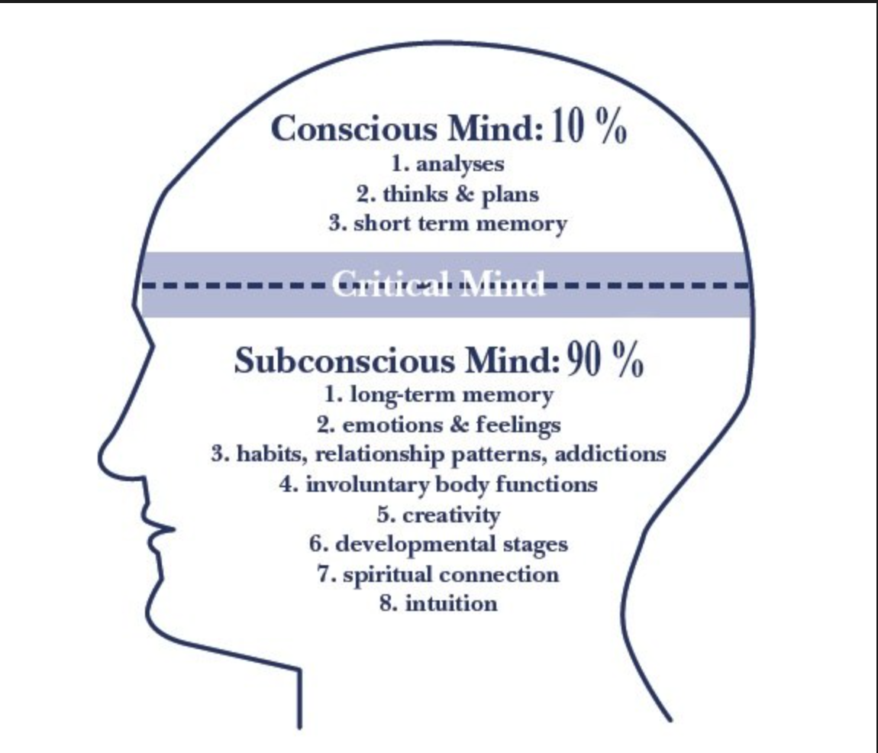
Notes:
Resource hosted by LSA Inclusive Teaching Initiative, University of Michigan (http://sites.lsa.umich.edu/inclusive-teaching/).
Connect to Stroop Test, processing information and learned associations (colors and words)
TALKING POINTS:
Reiterate that most of what we rely on is our subconscious mind. That subconscious mind holds so much of who we are - our long term memory, feelings, emotions, involuntary bodily functions, and is shaped by spirituality, developmental stages, and what many call their “gut instinct” or intuition. BUT when we rely on the subconscious, when we make decisions upon gut feelings, we have to question how that purported instinct was created.
The history of our country, media (in particular marketing), our families, teachers, workplace, and personal experiences, shape how we see the world and shape the connections we see. How we value ourselves and others. Tell us what is beautiful, who is or will be successful, who is an us and who is a them.

Slide 24
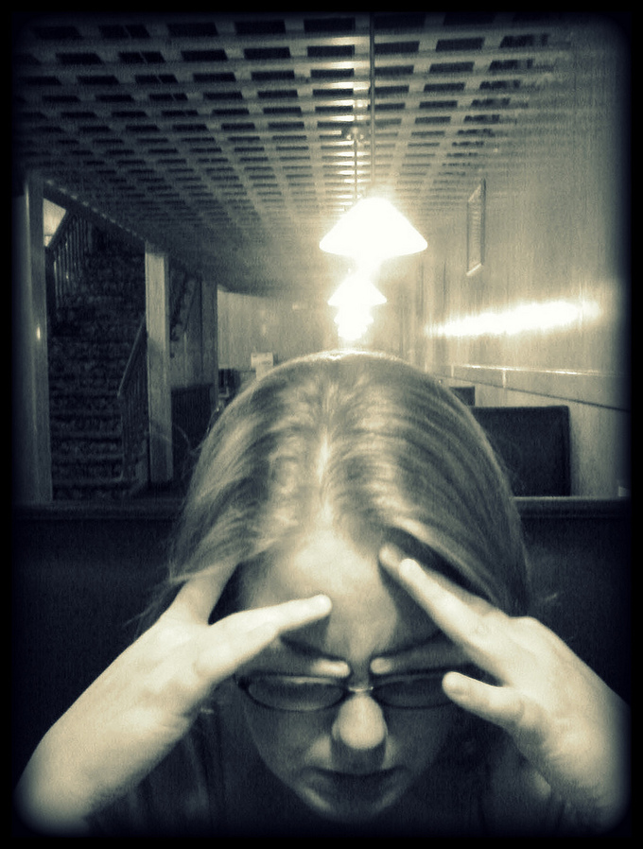
When are we MOST susceptible to Implicit Bias?
High pressure situations.
Certain emotional states.
Ambiguity in judgment.
Low-effort cognitive processing.
Lack of opportunities for feedback.
Notes:
Sources
Verna Myers, Moving Diversity Forward: How to Go from Well-Meaning to Well-Doing (ABA, 2011)
Daniel Kahneman, Thinking Fast and Slow. Farar, Straus and Giroux, NY. (2011)
Mahzarin R. Banaji, Anthony G. Greenwald, Blind Spot, Hidden Biases of Good People. Delacorte Press, NY (2013).
TALKING POINTS:
There are benefits to schemas, they allow us to function especially in high pressure, high stress situations, not to mention everyday life. The dual processing of our brains (the conscious and unconscious) can help us be more productive, make decisions quickly, and see the big picture. As pressure, stress, anxiety, and other emotions build, it is common to rely more heavily on the unconscious to move us to a decision. Think of any day that you felt stressed at work. Similarly, when we don’t have to process a lot of information, we complete tasks by rote. An example is driving home from work. How many turns did you make. Or cleaning up email after a vacation- quickly moving through each one to “get it done.”
The unconscious sorting, the reliance on our experiences, emotions, preferences, can result in judgments of individuals based on group stereotypes and biases.
In these situations we are moving too quickly through a decision – we need to slow down, pay attention, question our gut, examine why we are making a particular decision.

Slide 25
Harvard Implicit Association Test
Notes:
Provide IAT-Race link prior to training/workshops for participants to prepare to discuss at TTT. Not req’d to bring report/output https://implicit.harvard.edu/implicit/aboutus.html
Large Group Discussion
Invite participants to share their experience with this activity. They DO NOT need to share the results of the test.
Prompts for sharing:
What did you notice happening for you when you were taking the IAT-Race? (thoughts, concerns, feelings)
How did you feel when you were finished?
What surprised you or made an impression about the test, the process, or the results?
How comfortable would you be sharing your results (output) with a larger group?
What could you do to mitigate or decrease your personal racial bias?
Implicit Association Test: https://implicit.harvard.edu/implicit/takeatest.html
The implicit-association test (IAT) is a measure within social psychology designed to detect the strength of a person's automatic association between mental representations of objects (concepts) in memory.
A tool for measuring implicit bias
The Harvard Implicit Association Test for race reveals racial bias by measuring the amount of time it takes an individual to make an association between two concepts displayed as either words or images. So, for example, a person with implicit bias against African Americans might take longer to associate the word “good” with a Black face than with a White face.
Other tests exist – to determine bias, this is the most widely known.
We all have it. But this does not get you off the hook!

Slide 26
Harvard Implicit Association Test
Notes:
PLAY VIDEO CLIP (1 minute) – embedded in slide
https://www.youtube.com/watch?v=hr9xAcWv790. (5:13). TRIMMED to 1-minute clip
Results are overwhelming (3:30-4:33)
Lesson 5 in the Implicit Bias Video Series from BruinX, the R&D unit within UCLA's Office of Equity, Diversity and Inclusion.
Quick and dirty
Measures association speed with words and concepts (images) – sorting speed indicates strength of association; IAT Effect measuring strength and attitude with implicit preferences

Slide 27
Perceptions & Stereotypes
Can it make an impact?
Notes:
This section will explore how perceptions and stereotypes impact our thinking and behavior.

Slide 28
Perceptions
Notes:
Visual in how bias affect the individual.
Before playing the video ask participants to look out ways in which gender biases are highlighted.
After the video seek general responses from 2-3 participants before moving on.
PLAY VIDEO - (1:01) https://www.youtube.com/watch?v=B8gz-jxjCmg – embedded in slide
A Man's a Boss, a Woman's Bossy
SocialVoice LLC. Published on Dec 9, 2013
Bravo! P&G Pantene and BBDO Guerrero, Manila on their latest video that showcases the sad reality of gender labels and biases. NOTE: Social Voice LLC. does not own or have legal rights to this video. Copyright and legal rights to this video is owned by P&G Pantene and BBDO Guerrero, Manila.

Slide 29
Perceptions Activity
Write down 3-5 WORDS describing the person in each photo based on your first impression
OPM Police & Youth Interactions 2017
Notes:
Objective: Demonstrates how implicit biases or perceptions based on first impressions can have immediate consequences for how to approach/interact with individuals. We process our perceptions in quick time and react/respond in ways that may negatively impact individuals.
Virtual version: ask participants to write the first three words that come to mind for each picture in the chat. Trainer should indicate the picture number in the chat between each picture.
Ask if anyone has participated in this activity before they just observe at this time.
OPM Police & Youth Interactions 2017 PPT “Perceptions of Youth by Police”
SET UP 2-4 Flipchart sheets ahead of time with corresponding photo #s for pairs (not visible to audience) to record lists of descriptive words side by side.
1/7, 2/12, 3/11, 4/9, 5/8, 6/10
Opt. 1 – Individual Perceptions of ALL photos
DISTRIBUTE BLANK PAPER @ 1/person
Instruct to fold into 3rds, e.g. letter, then in ½; open out and #1-12 in the blocks using both sides of the paper, 1-6 and 7-12.
Show SLIDES/Photos # one at a time and allow 15 seconds to write up to 5 words in corresponding paper block # describing image – first impressions; done in silence.
Instructions:
Opt. 2 – Group Perceptions of SINGLE photos. PRINT AHEAD OF TIME and distribute ONE PHOTO (#1-12) to EACH table/group, face down and avoiding paired photos at same table or nearby.
“All at the same time, turn over the photo on your table, and in 2-3 minutes, write down words that describe the person in the photo based on your first impression.”
Process:
Show each photo in order #1-12, one at a time and elicit descriptive words, generating a list under each photo # on a flipchart set up with pairs alongside each other. Once all 12 SLIDE photos/FC lists have been completed,
Show paired photos in slides and review flipchart lists describing SAME person differently
DISPLAY the slide with the photographs of all six youth.
DISCUSS the differences in the lists made during the activity.
How did the youth’s appearance affect (the officers’) assumptions?
How might a youth’s location affect those assumptions?
--Is the youth located in front of a house, on a street corner, etc?
What else might result in officers making assumptions about youth?
--Time of day
--Neighborhood
--Who the youth is with
ASK: “What are the implications of this discussion for you (as patrol officers)?”
We are human and make assumptions like everyone else.
--People make assumptions to help them quickly assess a situation.
--Everyone has unconscious biases.
--People tend to view events and situations based on their cultural upbringing.
Ensure that unconscious bias does not affect your decision-making.
--Appearance may affect how we approach a youth initially.
--We should objectively assess what is really going on.
--Recognize tendencies to make assumptions.
--Try to treat everyone the same.
--Remember that all groups have bad, good, and average members in them.
Show youth respect first.
-- Avoid letting a youth’s appearance affect your approach.

Slide 30
Photograph #1

Slide 31
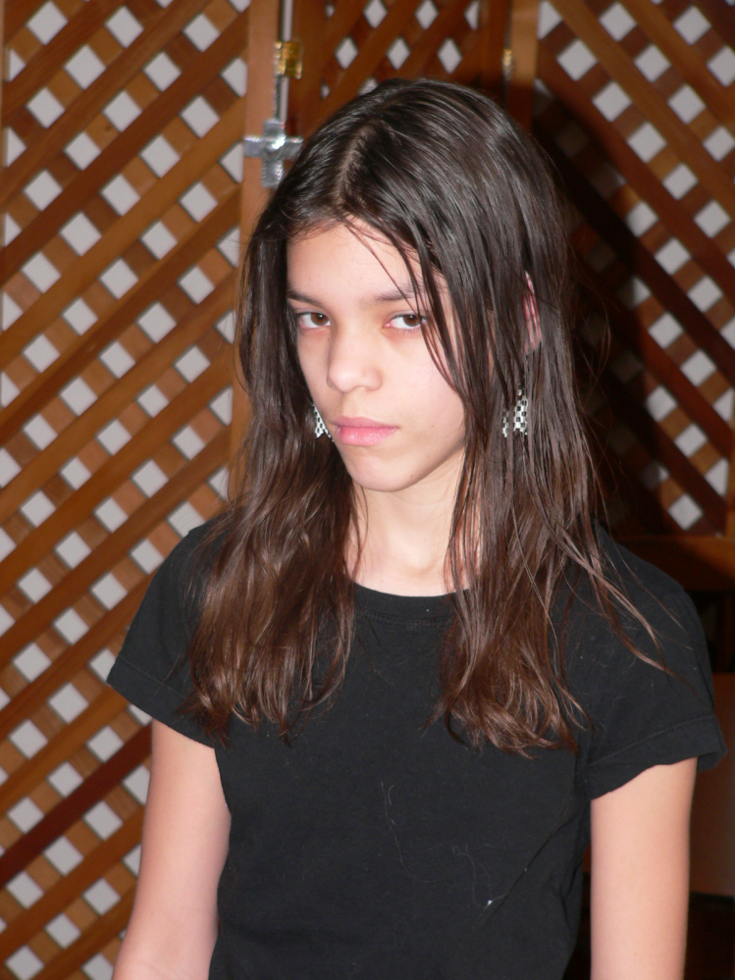
Photograph #2

Slide 32
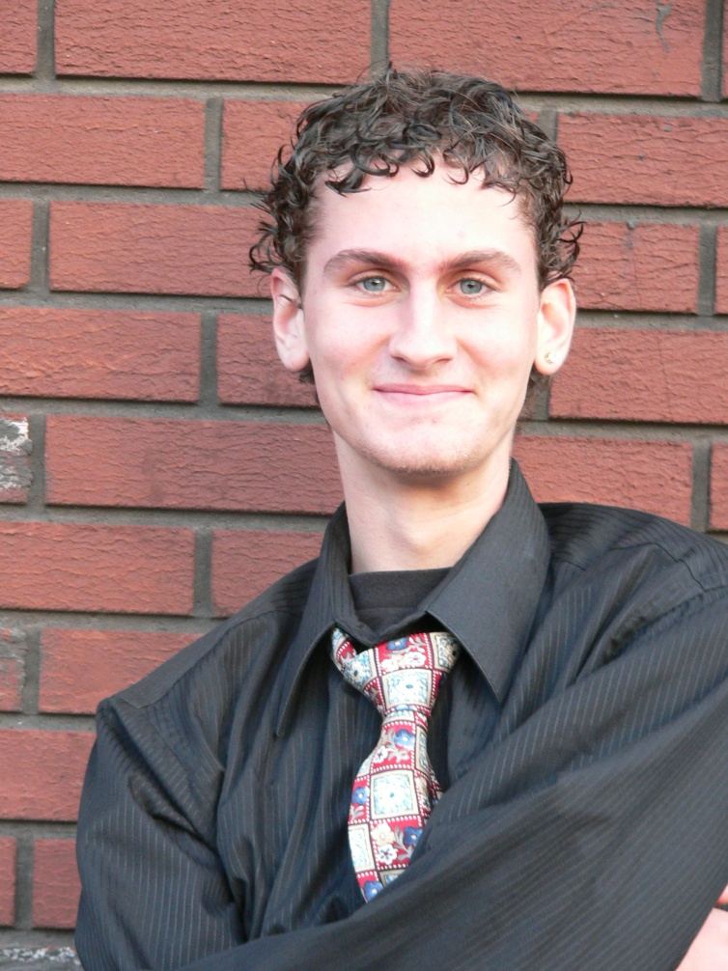
Photograph #3

Slide 33
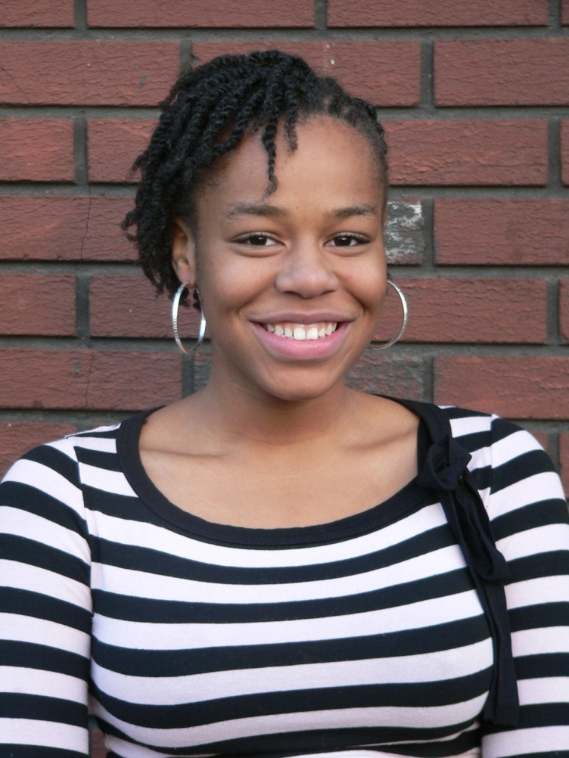
Photograph #4

Slide 34
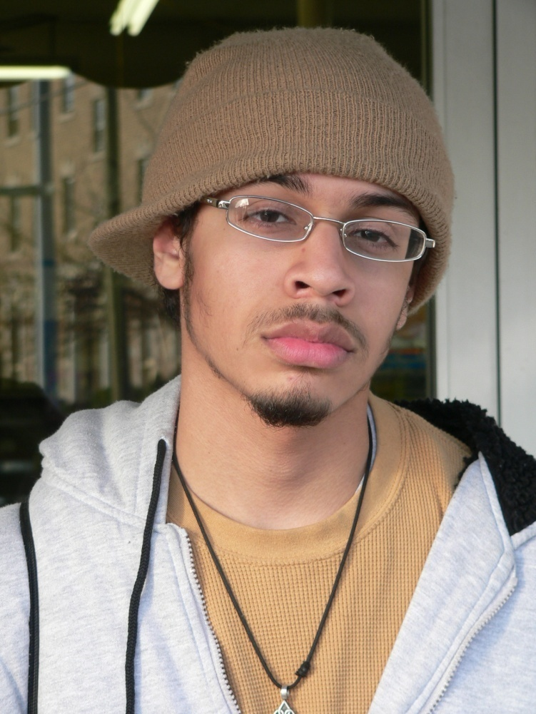
Photograph #5

Slide 35
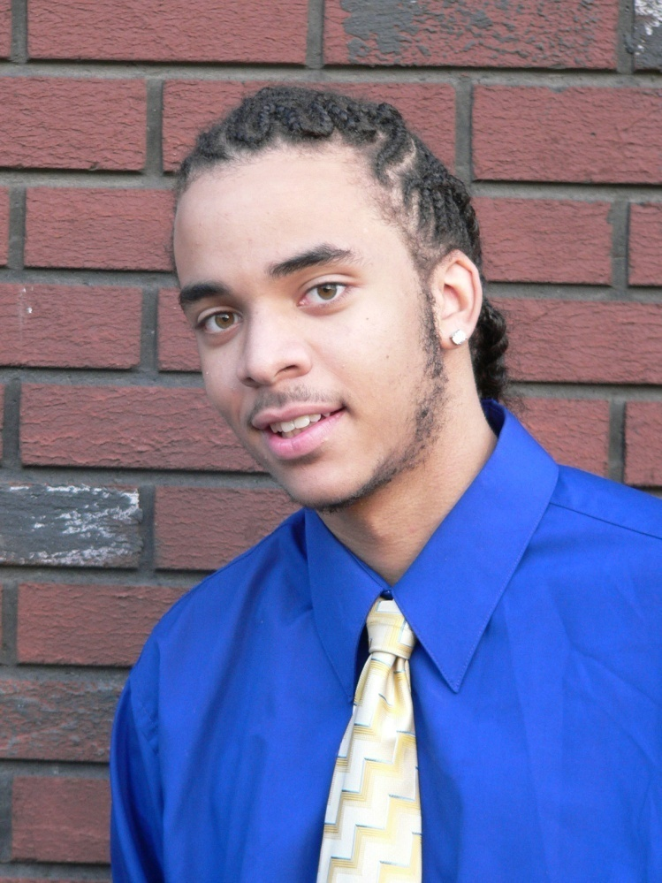
Photograph #6

Slide 36
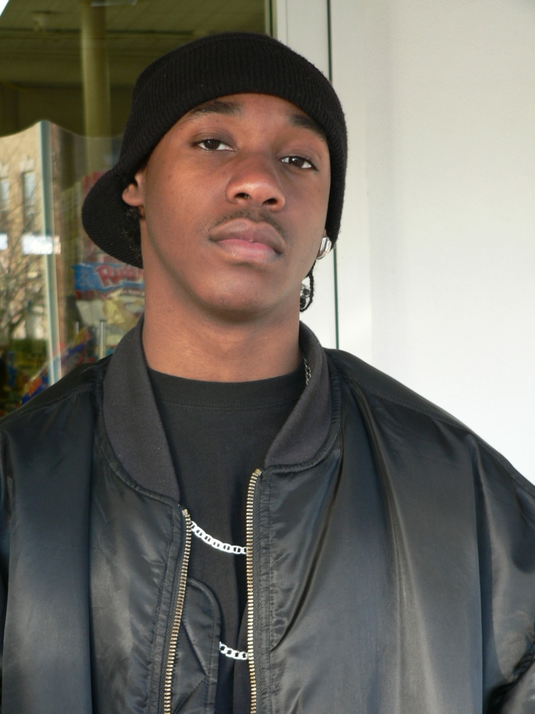
Photograph #7

Slide 37
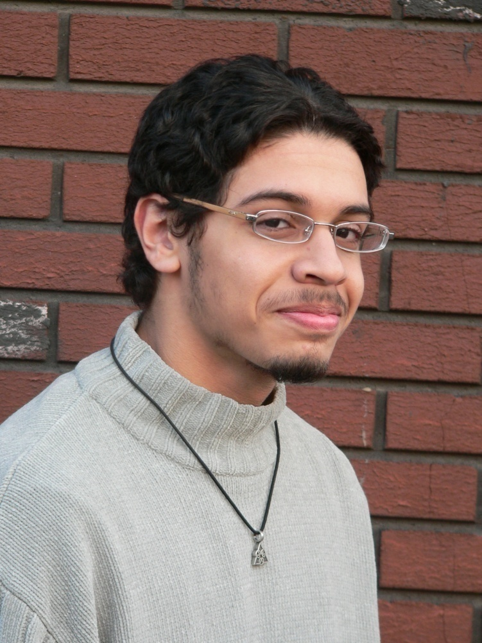
Photograph #8
Notes:
.

Slide 38
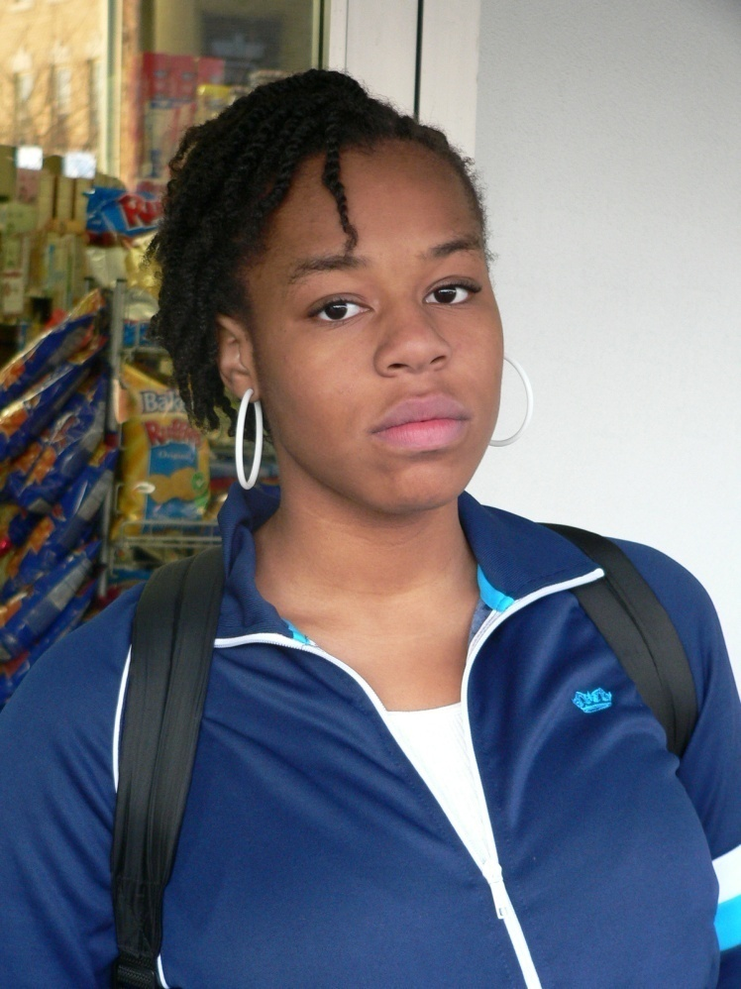
Photograph #9

Slide 39
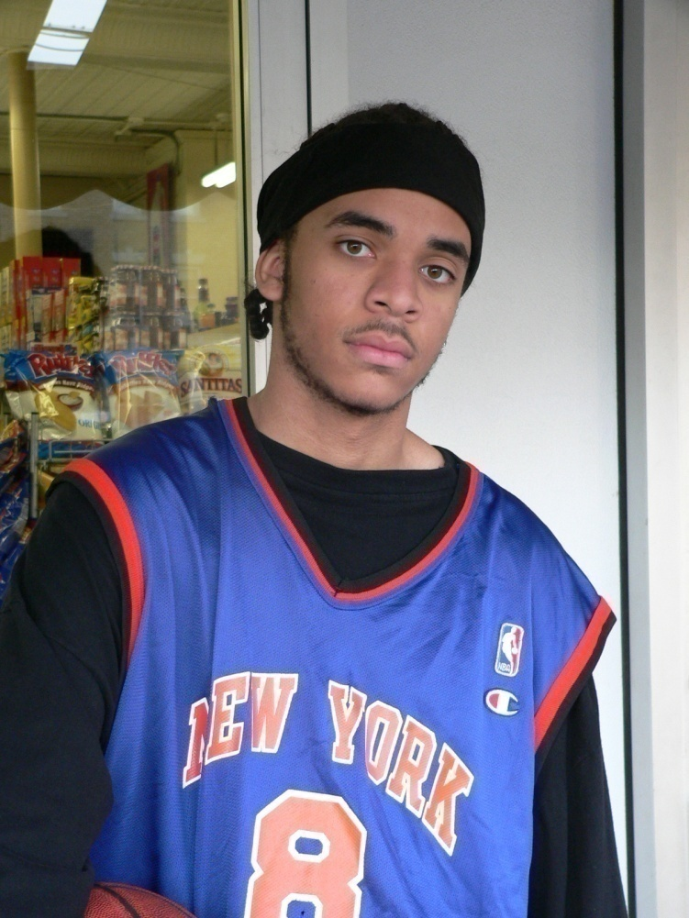
Photograph #10
Notes:
.

Slide 40
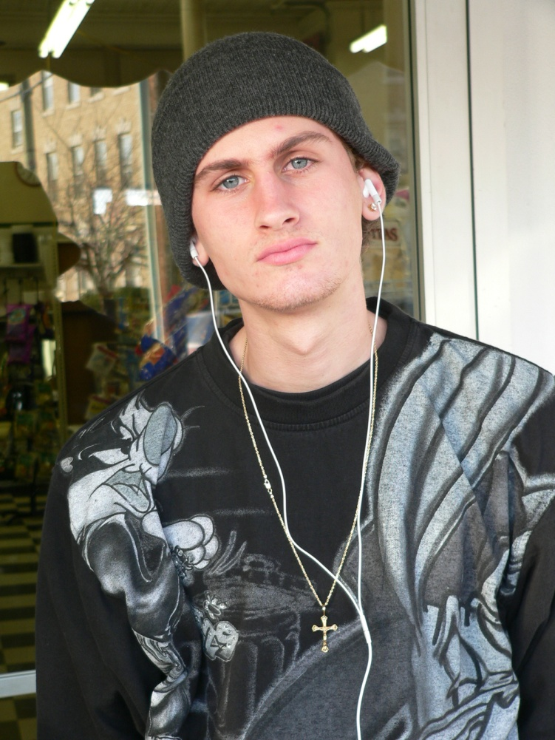
Photograph #11
Notes:
.

Slide 41
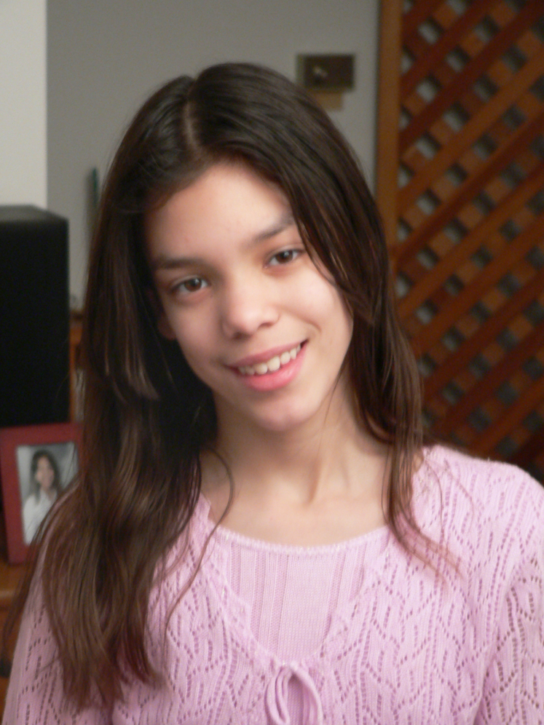
Photograph #12
Notes:
.Ask if anyone noticed anything about these photos (seeking if anyone recognized that they are the same children).

Slide 42
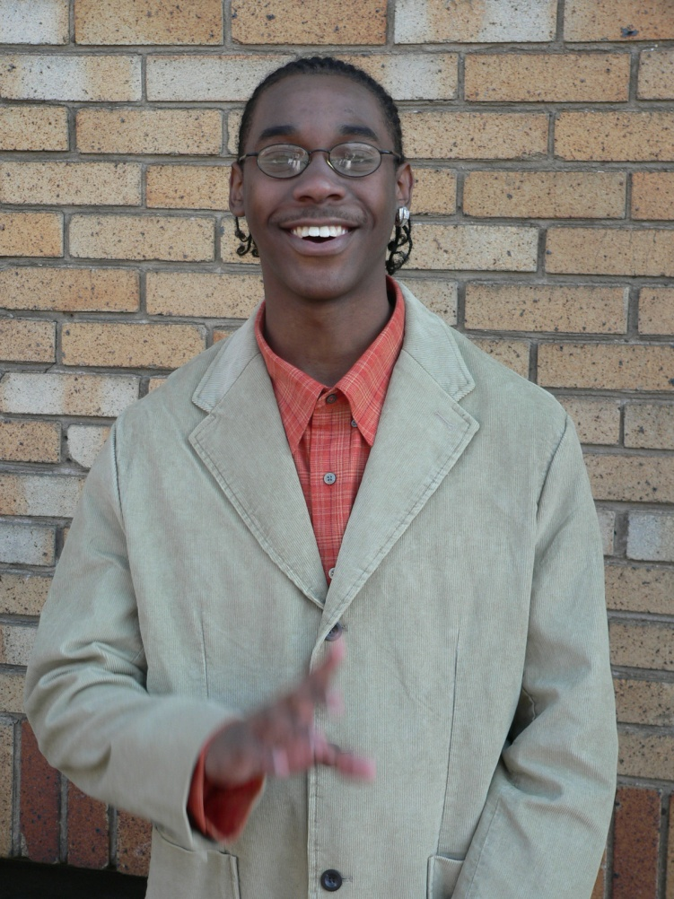
Photograph #1 and #7
Notes:
Review chat and compare the words used to describe the same youth.

Slide 43
Photograph #2 and #12
Notes:
Review chat and compare the words used to describe the same youth.

Slide 44
Photograph #3 and #11
Notes:
Review chat and compare the words used to describe the same youth.

Slide 45
Photograph #4 and #9
Notes:
Review chat and compare the words used to describe the same youth.

Slide 46
Photograph #5 and #8
Notes:
Review chat and compare the words used to describe the same youth.

Slide 47
Photograph #6 and #10
Notes:
Review chat and compare the words used to describe the same youth.

Slide 48
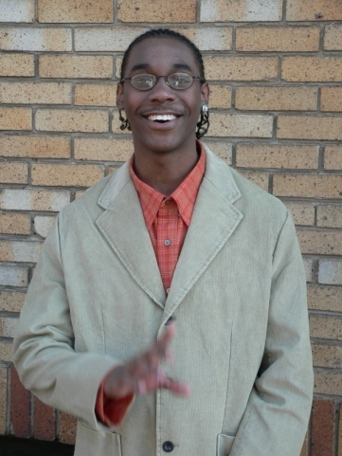
Debrief Perceptions Activity
Notes:
FINAL PROCESS
DISPLAY the slide with the photographs of all six youth (SLIDE 48)
DISCUSS the differences in the lists made during the activity.
How did the youth’s appearance affect your (the officers’) assumptions?
How might a youth’s location affect those assumptions?
--Is the youth located in front of a house, on a street corner, etc?
What else might result in officers making assumptions about youth?
--Time of day
--Neighborhood
--Who the youth is with
ASK: “What are the implications of this discussion for you (as patrol officers)?”
We are human and make assumptions like everyone else.
--People make assumptions to help them quickly assess a situation.
--Everyone has unconscious biases.
--People tend to view events and situations based on their cultural upbringing.
Ensure that unconscious bias does not affect your decision-making.
--Appearance may affect how we approach a youth initially.
--We should objectively assess what is really going on.
--Recognize tendencies to make assumptions.
--Try to treat everyone the same.
--Remember that all groups have bad, good, and average members in them.
Show youth respect first.
-- Avoid letting a youth’s appearance affect your approach.
APA article/source of perceiving black males as typically 5 yrs older ADDing to perceptions of black-crime associations as threats - BELOW
Trainer may choose to highlight some of the points from the article below:
March 6, 2014
Black Boys Viewed as Older, Less Innocent Than Whites, Research Finds
Police likelier to use force against black children when officers ‘dehumanize’ blacks, study says
WASHINGTON — Black boys as young as 10 may not be viewed in the same light of childhood innocence as their white peers, but are instead more likely to be mistaken as older, be perceived as guilty and face police violence if accused of a crime, according to new research published by the American Psychological Association.
“Children in most societies are considered to be in a distinct group with characteristics such as innocence and the need for protection. Our research found that black boys can be seen as responsible for their actions at an age when white boys still benefit from the assumption that children are essentially innocent,” said author Phillip Atiba Goff, PhD, of the University of California, Los Angeles. The study was published online in APA’s Journal of Personality and Social Psychology
Researchers tested 176 police officers, mostly white males, average age 37, in large urban areas, to determine their levels of two distinct types of bias — prejudice and unconscious dehumanization of black people by comparing them to apes. To test for prejudice, researchers had officers complete a widely used psychological questionnaire with statements such as “It is likely that blacks will bring violence to neighborhoods when they move in.” To determine officers’ dehumanization of blacks, the researchers gave them a psychological task in which they paired blacks and whites with large cats, such as lions, or with apes. Researchers reviewed police officers’ personnel records to determine use of force while on duty and found that those who dehumanized blacks were more likely to have used force against a black child in custody than officers who did not dehumanize blacks. The study described use of force as takedown or wrist lock; kicking or punching; striking with a blunt object; using a police dog, restraints or hobbling; or using tear gas, electric shock or killing. Only dehumanization and not police officers’ prejudice against blacks — conscious or not — was linked to violent encounters with black children in custody, according to the study.
The authors noted that police officers’ unconscious dehumanization of blacks could have been the result of negative interactions with black children, rather than the cause of using force with black children. “We found evidence that overestimating age and culpability based on racial differences was linked to dehumanizing stereotypes, but future research should try to clarify the relationship between dehumanization and racial disparities in police use of force,” Goff said.
The study also involved 264 mostly white, female undergraduate students from large public U.S. universities. In one experiment, students rated the innocence of people ranging from infants to 25-year-olds who were black, white or an unidentified race. The students judged children up to 9 years old as equally innocent regardless of race, but considered black children significantly less innocent than other children in every age group beginning at age 10, the researchers found.
The students were also shown photographs alongside descriptions of various crimes and asked to assess the age and innocence of white, black or Latino boys ages 10 to 17. The students overestimated the age of blacks by an average of 4.5 years and found them more culpable than whites or Latinos, particularly when the boys were matched with serious crimes, the study found. Researchers used questionnaires to assess the participants’ prejudice and dehumanization of blacks. They found that participants who implicitly associated blacks with apes thought the black children were older and less innocent.
In another experiment, students first viewed either a photo of an ape or a large cat and then rated black and white youngsters in terms of perceived innocence and need for protection as children. Those who looked at the ape photo gave black children lower ratings and estimated that black children were significantly older than their actual ages, particularly if the child had been accused of a felony rather than a misdemeanor.
“The evidence shows that perceptions of the essential nature of children can be affected by race, and for black children, this can mean they lose the protection afforded by assumed childhood innocence well before they become adults,” said co-author Matthew Jackson, PhD, also of UCLA. “With the average age overestimation for black boys exceeding four-and-a-half years, in some cases, black children may be viewed as adults when they are just 13 years old.”
Article: “The Essence of Innocence: Consequences of Dehumanizing Black Children,” Journal of Personality and Social Psychology, published online Feb. 24, 2014; Phillip Atiba Goff, PhD, and Matthew Christian Jackson, PhD; University of California, Los Angeles; Brooke Allison, PhD, and Lewis Di Leone, PhD, National Center for Post-Traumatic Stress Disorder, Boston; Carmen Marie Culotta, PhD, Pennsylvania State University; and Natalie Ann DiTomasso, JD, University of Pennsylvania.
Phillip Atiba Goff, PhD, can be contacted by phone at (310) 206-8614 (preferred) or by email. If Goff is unavailable, contact Matthew Christian Jackson, PhD, by phone at (814) 574-9781 or by email.

Slide 49
Does Implicit Bias Impact Our Professional Decision Making?
How does implicit bias impact:
Engagement with other co-workers?
Provision of services?
Ensuring there is a culturally competent service delivery?
Notes:
Trainer will process after activity:
After doing this activity- do you feel implicit bias impacts your role at work??
The trainer will ask the following questions to the group-
How does implicit bias impact:
Engagement with other co-workers?
Provision of services?
Ensuring there is a culturally competent service delivery?

Slide 50
HOW ARE YOU FEELING?
CAN THESE FEELINGS IMPACT OUR SYSTEMS?
Notes:
Indicate that now we understand what implicit bias is, has anyone begun to reflect on what some of their implicit biases could be?
Virtual version: Ask participants to select an emoji to put in the chat that reflects how they are feeling. Seek brief discussion or feedback on where people are with the content thus far.
Ask if these feelings impact our systems.

Slide 51
Implicit Bias in “Systems”?
Notes:
Elicit from participants/audience WHICH ”systems” continue to perpetuate ”bias” in policy and practices that result in certain social groups benefitting or being advantage OVER others being devalued or disadvantaged?
Discriminatory lending; i.e. housing and redlining, Tax Prep Advances, increased interest rates in car loans, predatory lending/pay day loans, etc. https://www.debt.org/credit/predatory-lending/
Education - school districts funding/geography, performance based, lack of resources (tax base)
Voting – ID laws, convictions, gerrymandering (redistricting), processes (ballot v. centers), deletions
Traffic stops – racial profiling
Stop and Frisk – NY
Employment – Ban the Box, training, lapses in history, unemployment, wages, “under the table,” certification requirements
Housing – subsidies, convictions,
Health Insurance
This next section will explore the impact of implicit bias in various systems, including our own at DCF.

Slide 52
The Child Welfare System

Slide 54
Themes Within DCF
Higher rates of black children living in impoverished neighborhoods, social deprivation, & family dysfunction.
Differential attention during the process of referral, intake, and service allocation.
Differences in the underlying incidence of actual maltreatment.
Worker’s values, professional judgment and biases lead to more substantiated reports.
Notes:
Trainer to review some of the findings outlined on the slide, highlighting ones that were not mentioned in the previous discussion.
This would be a good time to check in with the group regarding any questions.
Trainer will reiterate once again the importance and need for social workers to be aware of their biases, whether towards race, ethnicity, socioeconomic class, or a particular social problem. We all have biases and prejudices and must continually work towards not letting them affect our assessments.
Some efforts of the state to become less disproportionate are:
Racial Justice-7th Cross Cutting Theme (Race, Health, Education Inequities)
DATs-Diversity Action Teams in Area Offices, CO, Facilities??
Courageous Conversations
Undoing Institutional Racism(UIR)-”undo” racist structures that hinder effective social change. Premise: Racism has been systematically erected and can be “undone” if people understand where it comes from, how it functions, and why it is perpetuated.-i.e. analyzing power, defining racism, understanding the manifestations of racism, learning from history, sharing culture, & organizing to undo racism
Knowing Who You Are Trainings-gives an opportunity to develop a healthy sense of racial and ethnic identity, as well as to enhance psychological well-being and social competence.
Disproportionate Minority Contact (DMC) Trainings-Juvenile Justice, Police Officers
Ongoing Mandated Reporter Trainings
Walk a Mile in Our Shoes-Lunch Series

Slide 55
Implicit Bias in Education
Notes:
The trainer will give the back round before showing this clip: https://youtu.be/EQqAQgBwJxY – video embedded in picture.
Video was Published on May 19, 2017
Walter Gilliam, Director of the Zigler Center in Child Development and Social Policy, identifies who is getting expelled from preschool and how those decisions seem to be made. Preschoolers with the B’s : Boy, Big, Black- they were most at risk of being expelled- this video will explain how this connects to Implicit Bias.
Prior to playing, ask participants look out for how biases impact children in school and think about how this relates to our work at DCF.
Trainer should begin the video at the 4-minute mark to the end. (suggested that trainer opens this video and moves to the 4-minute mark prior to the start of training)
Seek thoughts and feedback following the video. Potential discussion prompts:
Who makes a lot of our referrals?
What happens when we perceive a child to be older than they are?

Slide 56
Notes:
90% of teachers are white and about 60% of our referrals come from schools.
Historically, there have been more teachers of color, but this has declined over the years.
Based on what you learned in the previous video, what is the potential impact of having such large majority of teachers who are white?

Slide 57
Notes:
2018-2019
Shows student percentages by ethnicity. This is very different than the make-up of the educator population.

Slide 58
Racial Demographics of CT Teachers
Statewide data show that:
Nearly one-quarter (44 of 201) of school districts in Connecticut employed no Black or Hispanic educators
Almost two-thirds (129 of 201) of school districts in Connecticut employed between zero and one Black or Hispanic educator for every ten positions,
Just over one-tenth (28 of 201) of school districts in Connecticut employed between one and four Black or Hispanic educators for every ten positions,
Black or Hispanic students attend schools in all school districts in the state,
Black or Hispanic student to educator ratios were lowest in mid-sized urban school districts, and
The number of Black educators in mid-sized urban school districts drove these ratios.
Notes:
Trainer to review stats, consider not reading word for word
Suggestions:
Highlight a couple of points
Ask participants to review the slide (allow a moment for participants to read on their own). Then ask participants to comment on a particular point that stands out to them and why.

Slide 59
Report on Student Discipline in Connecticut Public Schools February 2019
Though the suspension rates are higher for students of color, those rates are declining. The Black/African American suspension rate declined from 17.1 percent in 2013-14 to 14.3 percent in 2017-18 while the suspension rate for Hispanic/Latino students declined from 11.8 percent to 9.4 percent during that same period.
Notes:
Talking points for this chart:
Suspension rates are higher for students of color, those rates are declining.
Black/African American suspension rate declined from 17.1 percent in 2013-14 to 14.3 percent in 2017-18
Suspension rate for Hispanic/Latino students declined from 11.8 percent to 9.4 percent during that same period.
Disproportionality is still present.

Slide 60
Report on Student Discipline in Connecticut Public Schools February 2019
Notes:
This table highlights suspensions and expulsions for young children (pre-k – kindergarten). Suspending and expelling children this young is concerning in and of itself.
Attention has been given to this in recent years, and you can see some decline, but there is clearly more work to do.
There continues to be glaring disproportionality.

Slide 61
Report on Student Discipline in Connecticut Public Schools February 2019
Notes:
Chart reviews incidents of discipline. Again highlighting disproportionality based on race/ethnicity.

Slide 62
Implicit Bias
Police & Incarceration
On The Person, and within the Criminal Systems
Notes:
The next system we will look at is the criminal justice system.

Slide 63
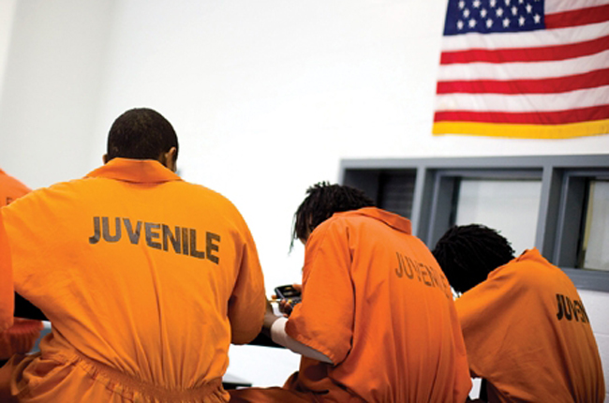
Juveniles Admitted in 2018
Race | Total Number
Black | 388
White | 294
Hispanic/Latino | 274
Unknown Race | 51
Asian/Pacific Islander | 3
American Indian | 2
Notes:
Shows higher rates of children of color involved with juvenile justice.
DCF’s efforts to address this:
Closing CJTS
Maintaining youth in the community (reduction of congregate care placements)

Slide 64
Impact of Bias – Incarceration & Police
Each year, more than 11 million people are locked up in local jails (3/4 for non-violent offenses)
Arrested and charged – but not convicted
Pretrial detention rates for blacks is 4 times > whites
Bail premiums - 35% more for blacks than whites
In 2016, nearly 1000 people killed in US by police
11% began with a traffic stop (equipment)
More than 99% of police contacts happen with NO police use of force
Racial bias is found both in speed of response and in decision to shoot (by police)
Notes:
Highlight some of the major points on this slide.
Bail premiums - 35% more for blacks than whites – What is the domino effect of this? (loss of job, housing, caregiver in the home, etc… because it costs more to get out and may not be financially possible for people of color).
Biased, Eberhardt, 2016, Pg 49, Pg 103, Pg 51
Pg 68 – police officers are faster to shoot blacks with guns than whites with guns, associating blacks with crime and danger.
Police who work in bigger cities, with larger black populations and higher crime rates, tend to exhibit the greatest racial bias in reaction time (to shoot)
Pg 80. Oakland Police Dept, on a typical day, an officer on patrol might hear “MALE BLACK” dispatched description 300 times – or 1200 times a week, 50,000 times a year.

Slide 65
Impact of Bias – Criminal System
Black people accept “criminal” label in plea-bargains
Public continues to associate blacks with crime
Black defendants are more likely than whites to be offered plea deals (requiring prison time, esp. for drug offenses) and rely on public defenders
Biased, Eberhardt, 2016
Notes:
Additional points. Seek feedback, thoughts from the group.
Biased, Eberhardt, 2016 Pg 109

Slide 66
Implicit Bias
Hospitals and Health Care
Notes:
The next section will look at bias in health care

Slide 67
Implicit Bias- Health Care
Since the majority of physicians are white and male, the unconscious assumptions they may hold about patients who are neither white nor male can lead to inappropriate treatment decisions, and on a larger scale, worsen disparities in health outcomes.
Stereotyping, biases and uncertainty on the part of healthcare providers can all contribute to unequal treatment
Can you name some?
Notes:
Review slide and illicit feedback from group about how bias surfaces in healthcare.

Slide 68
WHAT CAN WE DO?
Researchers have demonstrated that various intervention strategies are helpful:
Contact between members of different groups can work to reduce prejudice and intergroup conflict.
Perspective-taking- the ability to look beyond your own point of view, so that you can consider how someone else may think or feel about something.
Exposure to counter-stereotypical role models.
By taking the time to understand your personal biases, you can begin to mitigate their effects.
Notes:
Review slide about strategies for reducing the impact of implicit bias
For reference & additional talking points as appropriate
Intergroup conflict- In the midst of racial segregation in the U.S.A and the ‘Jim Crow Laws’, Gordon Allport (1954) proposed one of the most important social psychological events of the 20th century, suggesting that contact between members of different groups (under certain conditions) can work to reduce prejudice and intergroup conflict. Indeed, the idea that contact between members of different groups can help to reduce prejudice and improve social relations is one that is enshrined in policy-making all over the globe.
In the present world, it is this recognition of the benefits of contact that drives modern school exchanges and cross-group buddy schemes. In the years since Allport’s initial intergroup contact hypothesis, much research has been devoted to expanding and exploring his contact hypothesis.
https://www.in-mind.org/article/intergroup-contact-theory-past-present-and-future
Perspective taking is the ability to look beyond your own point of view, so that you can consider how someone else may think or feel about something.
To do this successfully, you must have some understanding of others’ thoughts, feelings, motivations, and intentions. You must also have some background information about the other person or be able to make some smart guesses about their background and or how they experience the world.
https://sociallyskilledkids.com/perspective-taking/
Counter stereotypical role model - Exposure of women in position of power is way to influence role stereotypes-Commissioner Dorantes is an example of a counter-stereotypical role model-a women in power.

Slide 69
Reflections & Questions
What will you do?
Notes:
Seek commitment from participants in what they will do to minimize implicit bias in their practice.
Open discussion to questions.

Slide 70
Post Survey- and-Impact Survey
2 weeks
2 months
Measuring effectiveness
Notes:
Participants will receive a post survey from the Academy 2 weeks after the training and managers will receive an impact survey 2 months after the training to measure the impact of this training and to determine if it is influencing practice.
Once again, a friendly reminder of the survey process-

Slide 71
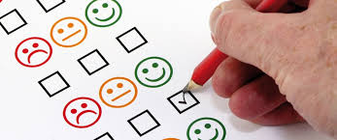
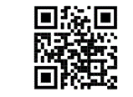
Training Evaluation Survey
Evaluations : https://tinyurl.com/y4zckdbq
Thank you!
Notes:
Evaluations/Surveys (or provide hyperlink if done electronically).
Virtual offering: put link to the eval in the chat and encourage participants to click on the link and complete the evaluation.

Slide 72
Resources
MacArthur Foundation Safety + Justice Challenge
CT Commission on Racial and Ethnic Disparity in the Criminal Justice System
Institute for Municipal and Regional Policy, Central Connecticut State University
State of CT, Judicial Branch, Court Support Services Division, Training Academy
CT Bar Association
UCONN School of Law
Greater Hartford Legal Aid
Notes:
RESOURCES:
Assessing Lawyer Traits & Finding a Fit for Success, JD Match & The Right Profile (white paper) at http://therightprofile.com/wp-content/uploads/Attorney-Trait-Assessment-Study-Whitepaper-from-The-Right-Profile.pdf
Banaji, Mahzarin R., and Greenwald, Anthony G., Blind Spot: Hidden Biases of Good People. Bantam (2013)
Bertrand, Marianne and Mullainathan, Sendhil, Are Emily and Greg More Employable Than Lakisha and Jamal? A Field Experiment on Labor Market Discrimination. NBER Working Paper. (2003). http://www.nber.org/papers/w9873.pdf.
Gladwell, Malcolm, Blink: The Power of Thinking Without Thinking. Little, Brown and Company (2007).
Gladwell, Malcolm, Outliers: The Story of Success. Little, Brown and Company (2008).
Hewleett, Sylvia Ann,et. al., “How Diversity Can Drive Innovation”, Harvard Business Review (Dec. 2013).
Kahneman, Daniel, Thinking Fast and Slow. Farrar, Strauss and Giroux (2011).
Kang, Jerry, Implicit Bias: A Primer for Courts. (2009). http://wp.jerrykang.net.s110363.gridserver.com/wp-content/uploads/2010/10/kang-Implicit-Bias-Primer-for-courts-09.pdf
McIntosh, Peggy, White Privilege: Unpacking the Invisible Knapsack (Wellesley, 1988). http://www.racialequitytools.org/resourcefiles/mcintosh.pdf
Myers, Verna, Moving Diversity Forward: How to go from Well Meaning to Well Doing. (ABA 2012). And generally, https://vernamyers.com/
Reeves, Arin., Written In Black & White: Exploring Confirmation Bias in Racialized Perceptions of Writing Skills. Yellow Paper Series (2014). http://www.nextions.com/wp-content/files_mf/14468226472014040114WritteninBlackandWhiteYPS.pdf
Staats, Cheryl, et. al., State of the Science: Implicit Bias Review Kirwan Institute (2016 Edition). http://kirwaninstitute.osu.edu/wp-content/uploads/2016/07/implicit-bias-2016.pdf
See Generally:
Deloitte University Leadership Center for Inclusion: https://www2.deloitte.com/us/en/pages/about-deloitte/articles/deloitte-university-leadership-center-for-inclusion.html#
Kirwan Institute: http://kirwaninstitute.osu.edu
Project Implicit, Harvard Implicit Association Test: https://implicit.harvard.edu/implicit/takeatest.html
Gender Bias - https://www.youtube.com/watch?v=JFW2cfzevio
Implicit Bias in hiring - https://www.youtube.com/watch?v=Q0ne13lv8hE
ealize TIME remaining. Elicit reflections, reactions, responses as well as Questions from audience participants.

