Slide 1
Understanding Adolescent Development and Recognizing Trauma Among Youth
Chelsea Morales, Psy.D.
Post Traumatic Stress Center, New Haven, CT

Slide 2
Goals of this Training
Understand typical adolescent development
Understand how trauma impacts adolescent development
Be able to recognize the warning signs of traumatic stress
Know when and how to intervene

Slide 3
Trauma
A deeply distressing or disturbing experience
Exposure to death, threatened death, actual or threatened serious injury, or actual or threatened sexual violence of self or loved one
Direct Exposure
Witnessing
Indirect Exposure
Simple versus Complex Trauma
Simple = Single, discrete incident
Complex = Prolonged, recurrent

Slide 4
Coronavirus Pandemic as a Trauma
Meets criteria for trauma:
Direct Exposure
Witnessing
Indirect exposure
Students and their families being affected by: illness, financial difficulties, death, loss, grief, isolation, food insecurity...etc
Students who have never experienced trauma prior to this developing symptoms of anxiety and depression
Students who have experienced trauma but were able suppress and cope, no longer able to compartmentalize
Students who have experienced trauma but were struggling prior to pandemic, symptoms exacerbated

Slide 5
Critical Issues
Trauma is more pervasive than you may realize
Trauma does not respond to typical disciplinary actions
Trauma elicits reactivity
Trauma creates a barrier to learning

Slide 6
Think of a Children You Serve
Who are they?
What is their story?
What about them drives you nuts?
What draws you to them?

Slide 7
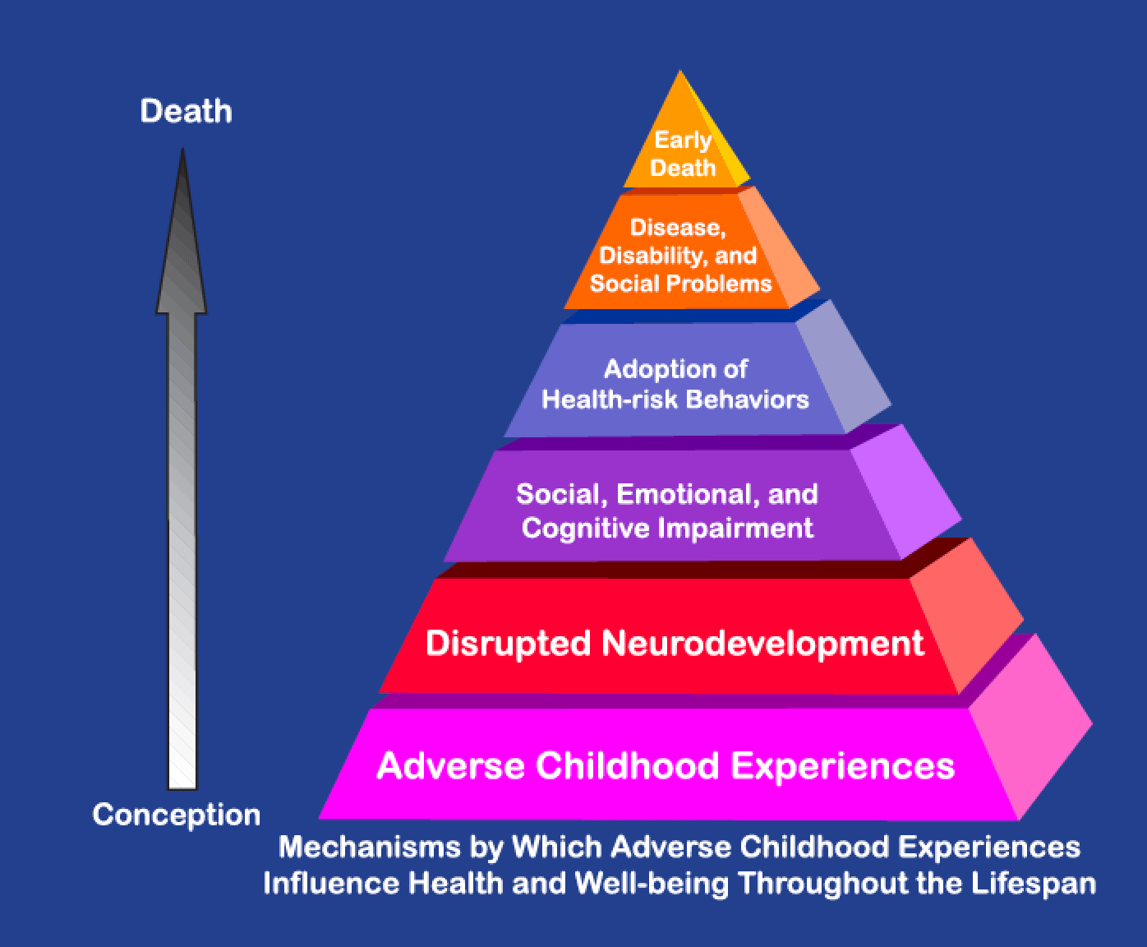
Adverse Childhood Experiences Study (ACES)
CDC-Kaiser Permanente
ACE Study (1998)*
Findings: adverse childhood
events have a direct correlation
to negative outcomes in
adulthood
*Felitti et al. 1998
Ted Talk: How Childhood Trauma Affects Health Across a Lifetime- Dr. Nadine Burke-Harris

Slide 8
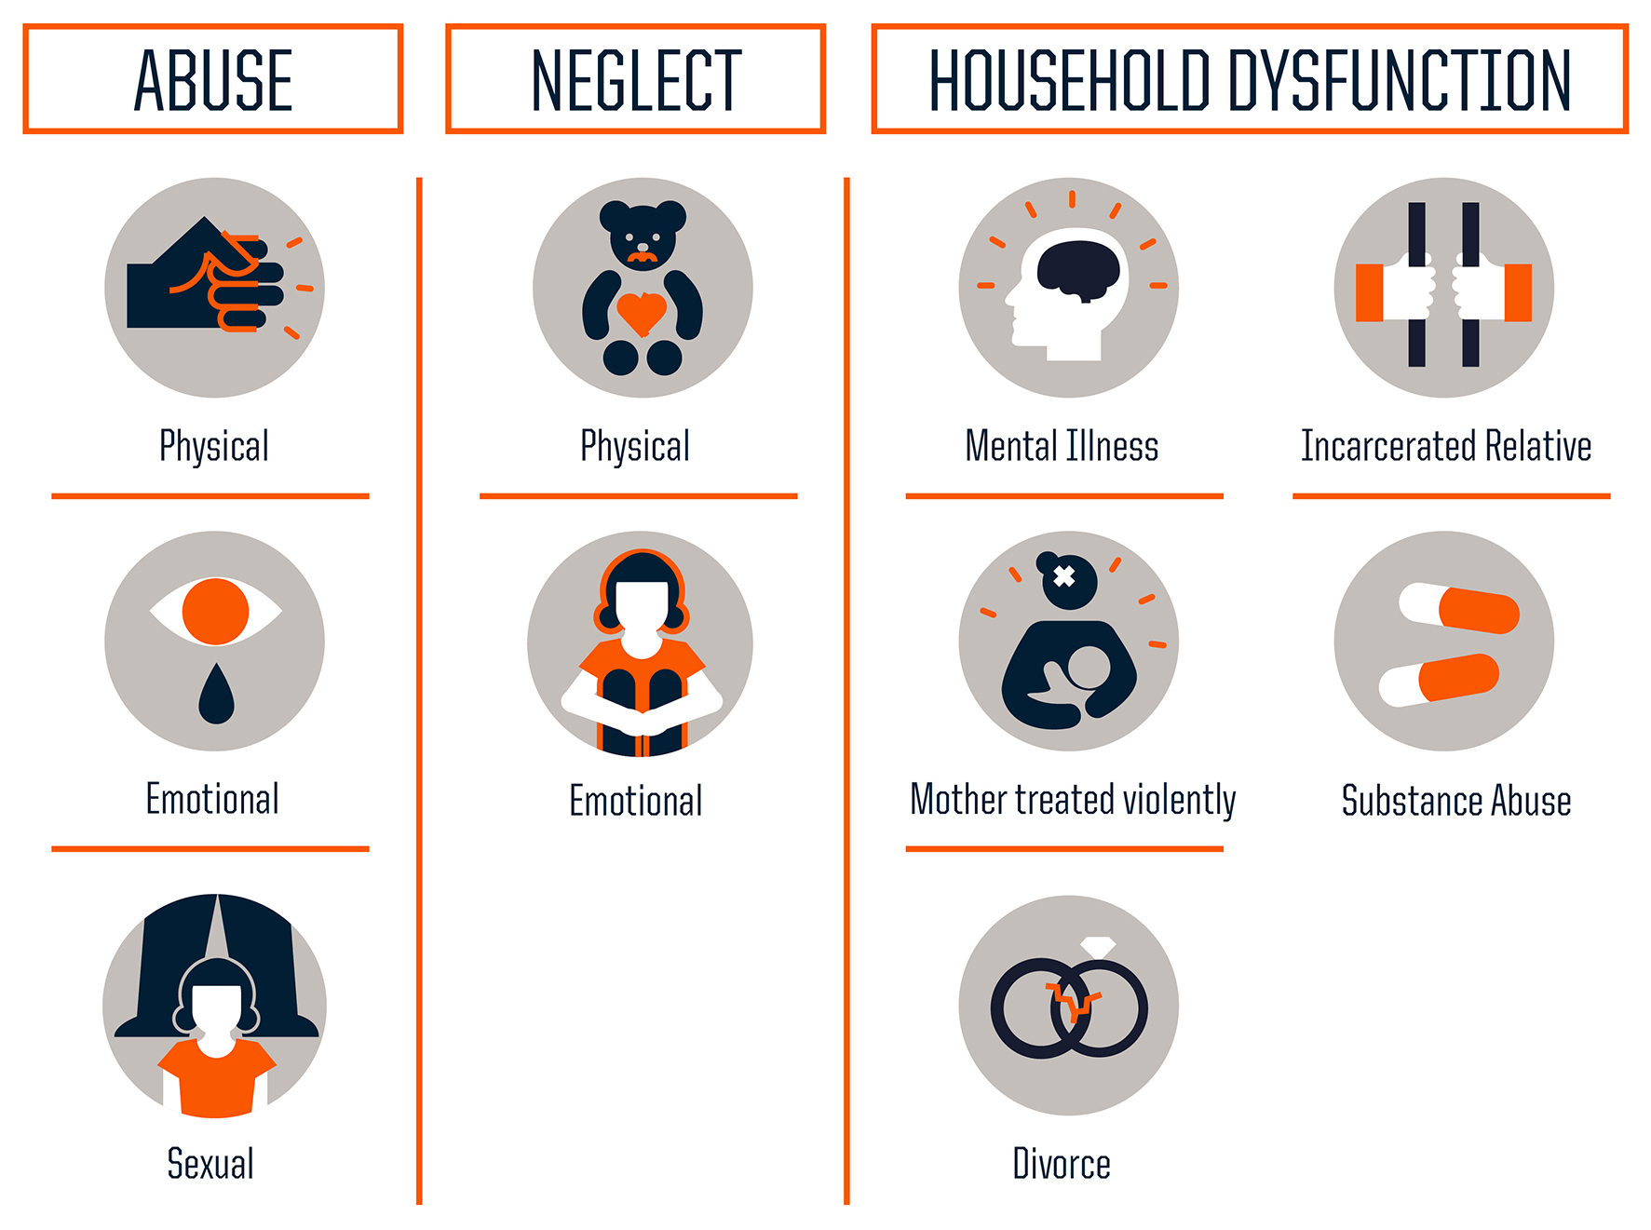
Types of Toxic and Traumatic Stress
Death/ Loss
Racism
Divorce
Fire
Vehicle Accident
Natural Disaster

Slide 9
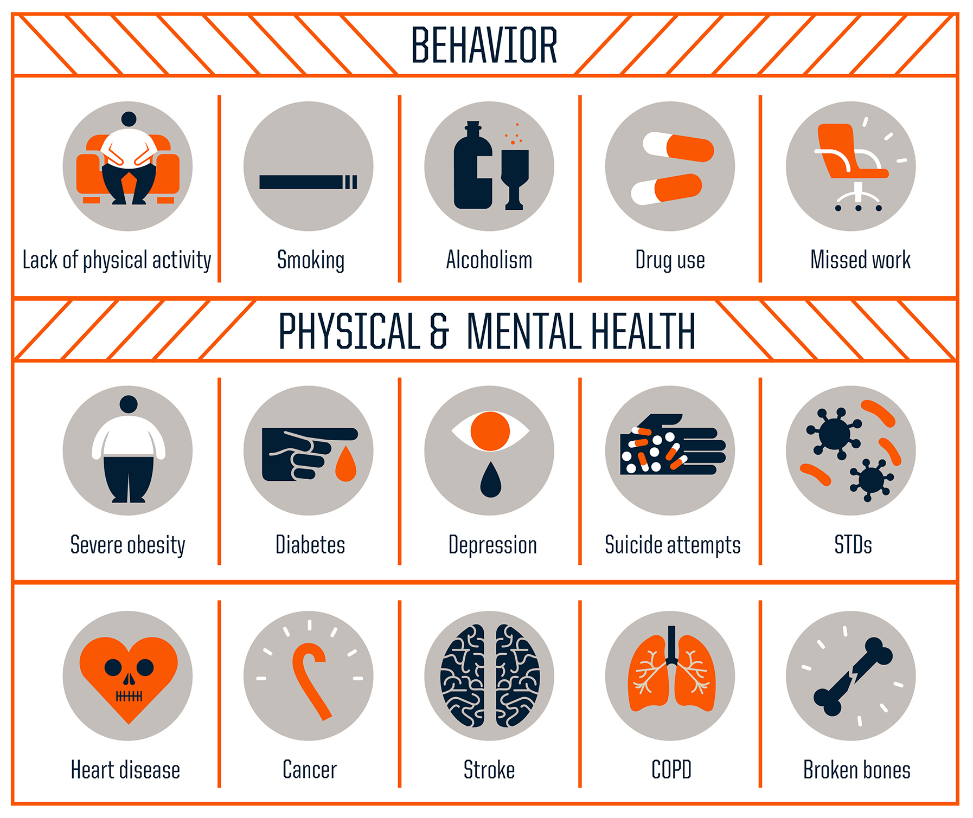
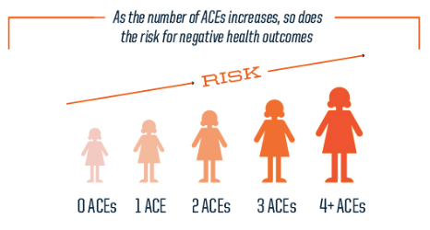
Impacts of Traumatic Stress

Slide 10
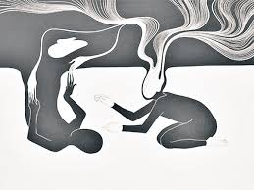
Core Experiences of Trauma
Fear/ Horror/ Shame
Isolation
Lack of Rescue
Helplessness
Hopelessness
Feeling Out of Control

Slide 11
How Coronavirus is Related to the Core Experiences of Trauma
Fear and horror associated with seeing people around you become ill and potentially die from the virus
Shame of possibly infecting others
Lack of rescue associated with not knowing when the end will be
Helplessness and hopelessness associated with the magnitude of the pandemic
Feeling out of control and isolated because they are not able to go about their normal routine, quarantine, not being able to see friends, required to wear masks, can’t go to school...etc

Slide 12
In adolescents, symptoms of trauma or toxic stress show up as:
Headaches
Stomach Aches
Truancy
Angry outbursts
Isolation

Slide 13
How children may be responding to the pandemic
Recall the three students I mentioned earlier:
Never experienced trauma, now showing signs of distress
Experienced trauma/able to cope, now showing signs of distress
Experienced trauma/not able to cope before, symptoms exacerbated
For students that have previously experienced trauma, there may be a sense of familiarity with the chaos of the pandemic, may feel less anxious because isolation has been a primary method of coping, however, may be showing signs of depression.
For other students that have previously experienced trauma, the pandemic may be a trigger (reminder of their past trauma) and may cause them to show more (frequency/intensity) symptoms of trauma mentioned on the previous slide

Slide 14
Now the Good News!
Children are resilient
Young brains are malleable
Effective treatments exists
Post traumatic growth can occur
It Only Takes 1 Person to Help Build Resilience

Slide 15
Typical Adolescent Development
Physical
5 Domains:
Social
Cognitive
Behavioral
Emotional

Slide 16
Typical Cognitive Development
Working towards:
The ability to reason effectively
Problem solving
Thinking abstractly
Reflecting
Planning for the future

Slide 17
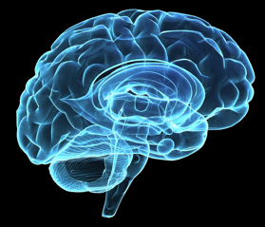
Typical Brain Development: 3 Main Structures
Cerebral Cortex: (Outer)
Thinking, planning, decision making
Limbic System: (Middle)
Emotions – fear and pleasure center
Memory
Cerebellum: (Rear)
Breathing, heart beat, motor skills
-

Slide 18
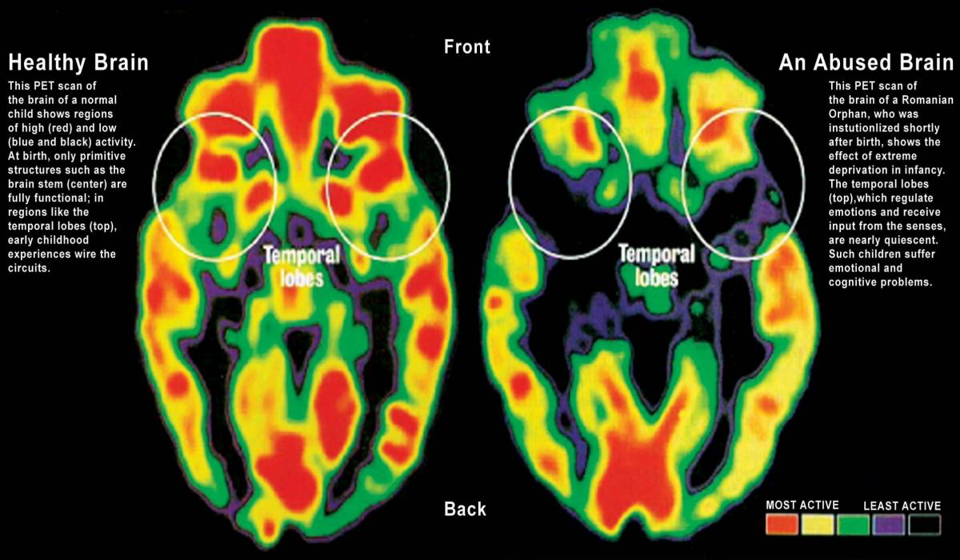
Trauma and Brain Development
Disruption in development in the prefrontal cortex and executive functioning (thinking, planning, decision making)
Stuck in a hyperaroused state:
Autonomic reactivity
Emotional reactivity

Slide 19
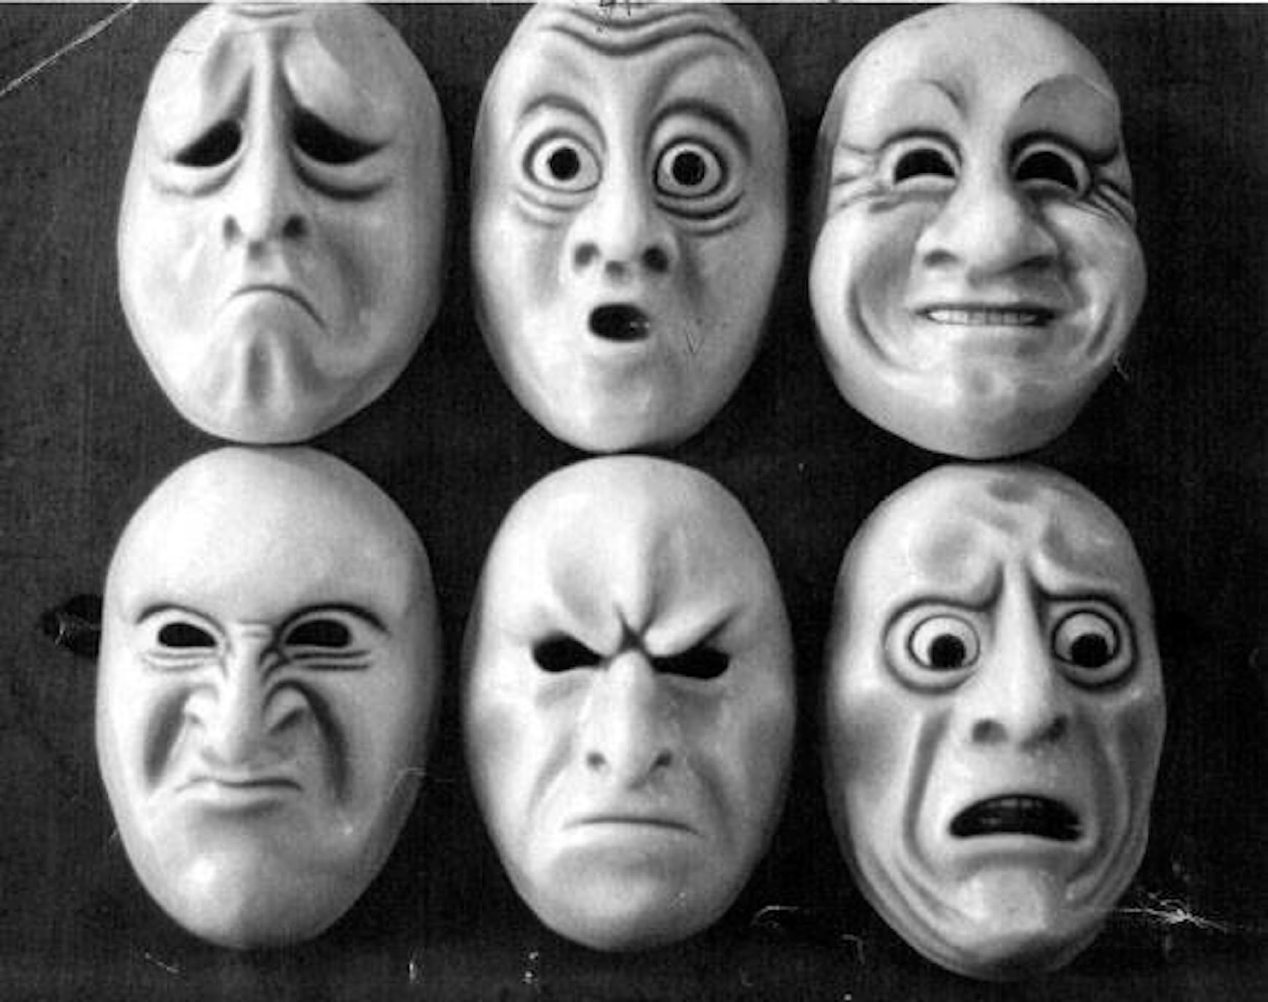
Typical Emotional Development
Recognizing and managing emotions
Developing empathy
Learning how to resolve conflict
Self-Esteem

Slide 20
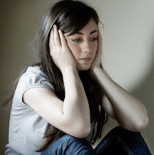
Trauma and Emotional Development
Without Trauma | With Trauma
Recognizing and managing emotions | Can’t control feelings: Sadness, anger, anxiety, fear Emotional Numbing
Developing empathy | Perspective taking is impaired Misunderstanding facial expressions
Learning how to resolve conflict | Black and white thinking Feeling the world is “unfair”
Developing self-esteem | Identifying with the trauma: helpless, victim, no-good, worthless Negative self-image

Slide 21
Typical Social Development
Searching for identity
Seeking independence
Looking for new experiences
Need for belonging in groups

Slide 22
Trauma and Social Development
Searching for identity Identity Distortion
Seeking independence Overly dependent or withdrawn
Looking for new experiences Heightened risk taking
Need for belonging in groups Rigid Thinking: pushing others away or intensified need for belonging

Slide 23
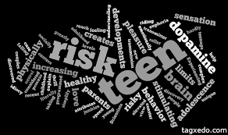
Typical Adolescent Risk Taking Behavior:
Experimentation and/or
abuse of substances
Sexual experimentation and
pregnancy or STD
Some delinquency

Slide 24
Trauma and Behavior
Academic Disengagement
Issues with Authority
Peer Relationship Issues
Somatic/ Body Responses

Slide 25
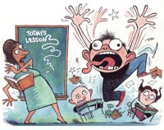
Recognizing Signs of Trauma in Adolescents

Slide 26
When do you enter Traumaland?
The child cannot tell the difference between past and present
The child sees the current situation as potentially harmful
Normal disciplinary actions are not successful
PAST
PRESENT
Trauma
School

Slide 27
You have become the Perpetrator
Lack of differentiation makes you seem like the bad guy
You become frustrated and want to make them stop what they are doing
Everyone involved becomes scared, angry, overwhelmed, hopeless, etc.

Slide 28
What does this look like in the age of Covid-19?
Academic Disengagement
Truancy
Looking withdrawn
Anger outbursts
Refusing to wear a mask or keep social distance during in school instruction
Becoming more easily frustrated or upset
Notes:
Hybrid and distance learning can definitely interfere with feeling connected to your students. It might be harder to pick up on student’s distress or it might be more blatant as their distress tolerance may be significantly decreased with the uncertainty of living through a pandemic. It is also important to remember that EVERYONE is under a significant amount of stress right now. Everyone’s life (personal/professional/academic) has been greatly impacted by this virus. There are still ways that you can connect with students that may be helpful.

Slide 29
How do you take care of you?
Working with children that have trauma and working in the midst of a pandemic are extremely stressful. Here are some things that you can be doing to take care of yourself in order to be effective in doing this work:
Reaching out to your supports within the building
Having a good work/life balance
Doing things you love outside of work (find new hobbies in the midst of the pandemic)
Exercise
Reminding yourself that the hybrid learning arrangement is temporary

Slide 30
Knowing When and How to Intervene
When normal disciplinary actions aren’t working, a shift in perspective is necessary:
“What’s wrong with you?”
“What happened to you?”

Slide 31
The Importance of Validation
Trauma Happens in Isolation…. Healing Happens in Relationship…
Get curious! Ask Questions!
…Validate their experience and let them know they are strong!

Slide 32
The Miss Kendra Mantra
We SEE you are upset.
We KNOW that this for a good reason.
We ASK what is happening/ has happened.
We CAN help you feel better and succeed in school.
We WILL keep checking in with you!

Slide 33
Using the Miss Kendra Mantra
Can be used with both children you have a relationship and students you are less familiar with
De-escalates a child by making them feel seen and acknowledging their inner world
Reassures them that adults care about their success and want to support them
Helps to create a norm around being curious about children’s experiences

Slide 34
Additional Resources
Mobile Crisis Intervention Services: Dial 211
National Childhood Stress Network: www.nctsn.org
Adverse Childhood Experiences Study: www.acestudy.org
Aces Connection: www.acesconnection.com
National Suicide Prevention Lifeline: 1-800-273-8255

Slide 35
Q&A

